Slide 1
Parks, Trails, & Rec Facilities NRPA Data Model
The National Recreation & Park Association (NRPA) has developed a GIS data model for parks, trails and recreation facilities in an effort to standardize these types of GIS data.
The purpose of the project is to have local governments collect consistent information in their GIS systems allowing for better local, regional and statewide management and planning of park and recreation resources.
Assisting the project was a consulting team consisting of Applied Geographics and the non-profit GreenInfo Network.

Slide 2
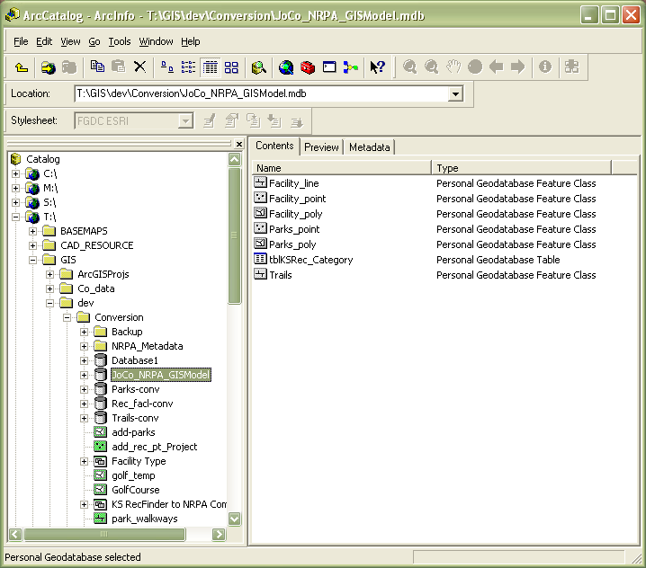
Johnson County – NRPA Model
The NRPA Model
Personal Geodatabase with 6 feature classes
The proposed Jo Co model uses 3 feature classes:
Parks_poly
Trails
Facility_point
Several attributes have been added to the basic NRPA Model

Slide 3
Johnson County – NRPA Model
Advantages of the NRPA Model
Rich attribute structure
Consistent data and structure for sharing between multiple agencies
Kansas is moving to the NRPA model for the KS Rec-Finder, the GIS data that feeds into the Statewide Comprehensive Outdoor Recreation Plan (SCORP)
Converting the Jo Co data to the NRPA Model has provided the opportunity to improve the accuracy and completeness of the countywide recreation GIS data

Slide 4
Johnson County – NRPA Model
Disadvantages of the NRPA Model
There are a lot of attribute fields to edit
Local agencies have significant investment in their current model for this data.
Current countywide data does not have values for many of the attributes. A fair amount of data will need to be collected to complete the data model.

Slide 5
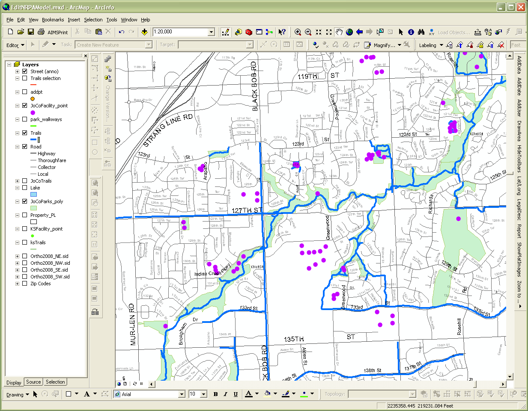
Johnson County – NRPA Model
Current state of the data – Parks
449 records
Reasonably complete attribute records
Includes golf course properties and some private recreation complexes
Both property owner and managing agency are listed
Addresses checked against AIMS address points
Park_ID can be linked to KS Rec-Finder records

Slide 6
Johnson County – NRPA Model
Parks

Slide 7
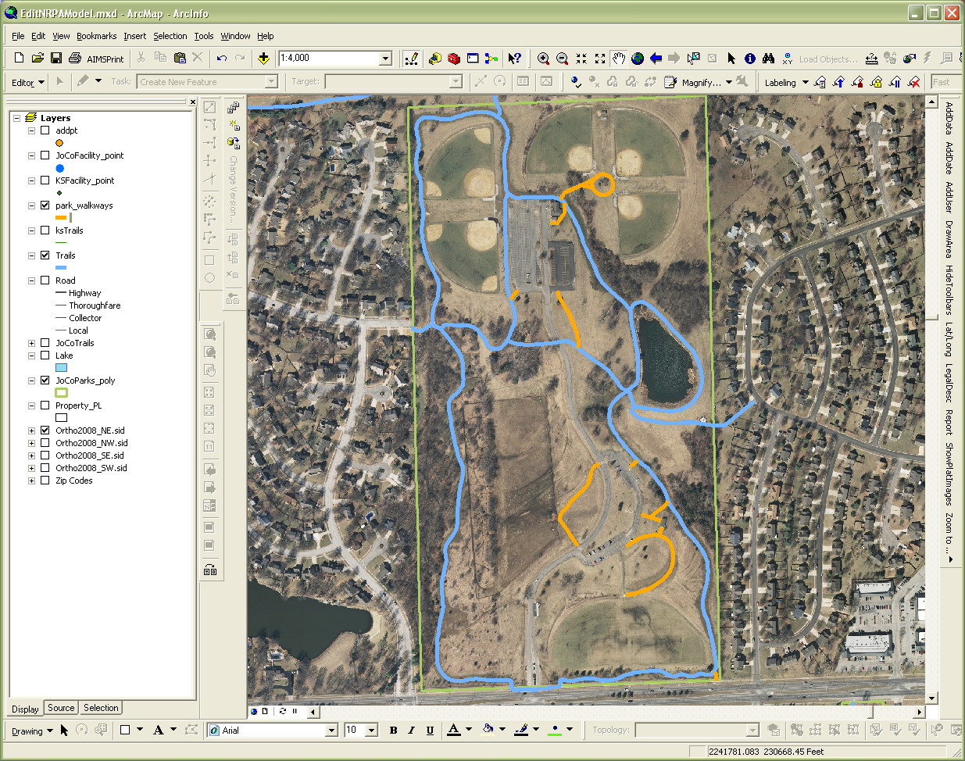
Johnson County – NRPA Model
Current state of the data – Trails
1847 trail segments
Reasonably complete attribute records
Does not include park sidewalks (these may be added later)

Slide 8
Johnson County – NRPA Model
Trails

Slide 9
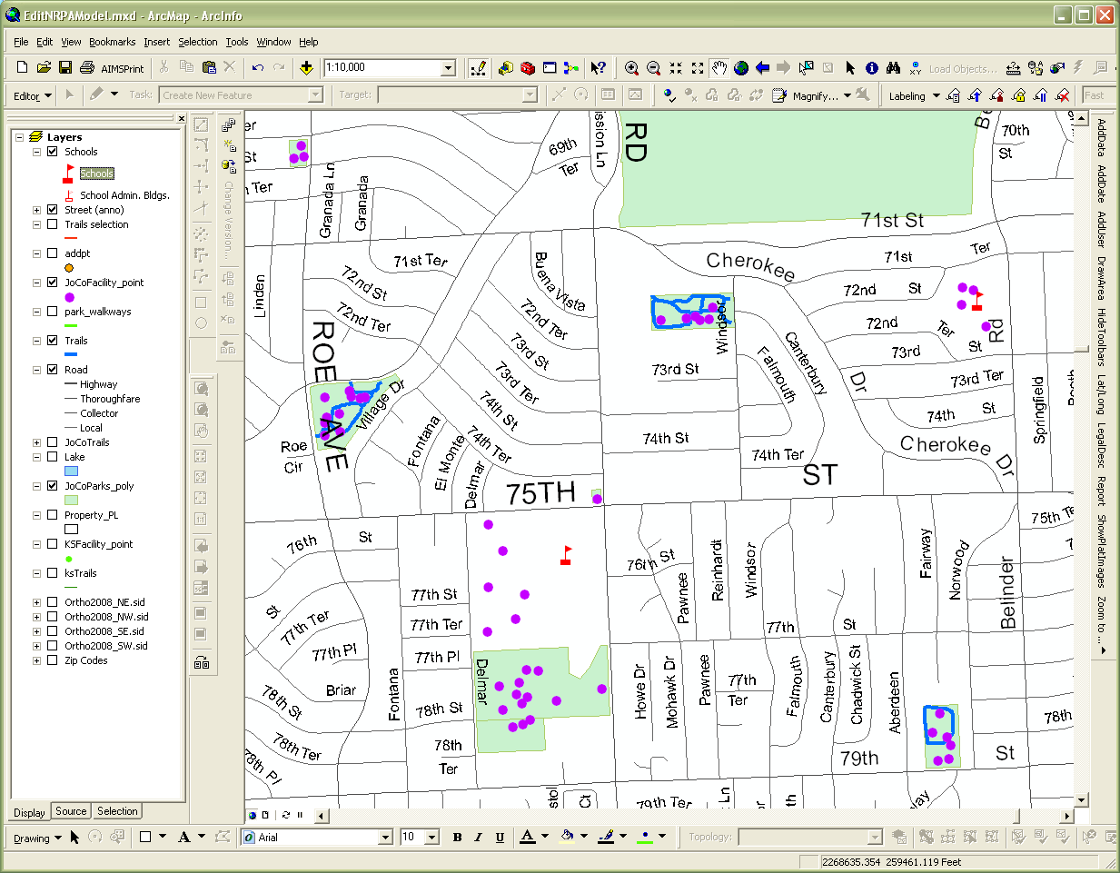
Johnson County – NRPA Model
Current state of the data – Rec Facilities
1905 points,
Improved data quality, most addresses checked against AIMS address points
Includes school sport fields, courts, and playgrounds
Reasonably complete attribute records
Limited number of records with KS Rec-Finder ID

Slide 10
Johnson County – NRPA Model
Rec
Facilities

Slide 11
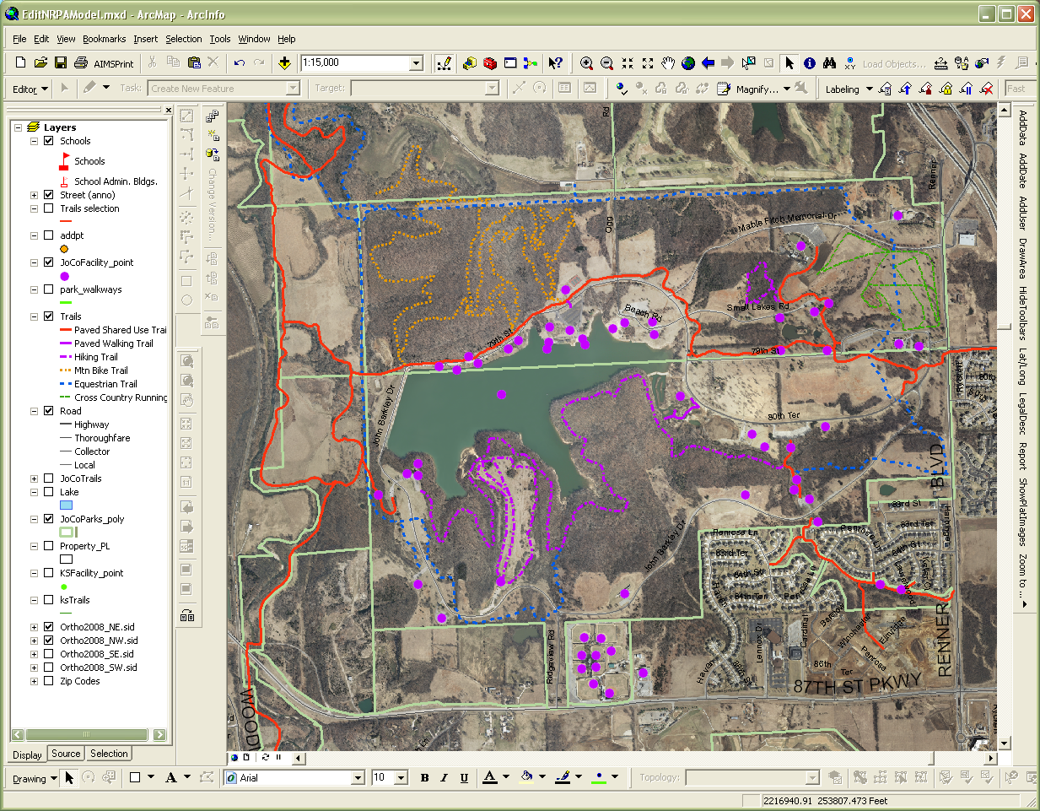
Johnson County – NRPA Model
Future Steps
Establish unique IDs
Add attributes that are useful to the AIMS community
Complete metadata and publish
Work with the cities to complete and improve records
Work with MARC and KS Rec-Finder to improve model compatibility and data exchange
Suggestions for improvements and implementation
Cliff.Middleton@jocogov.org
(913) 894-3342
Questions

