Slide 1


Using LiDAR Data for Engineering Projects
AIMS Coordinators Meeting
April 11, 2013
Peter Moody, AIMS
Chet Belcher, Phelps Engineering
913-393-1155

Slide 2
Engineering Applications
Preliminary Studies
Design Projects
  Linear Projects (Creek/Roadway)
  Development Projects
FEMA Floodplain Updates
  Hydraulic Models
  Floodplain Mapping

Slide 3
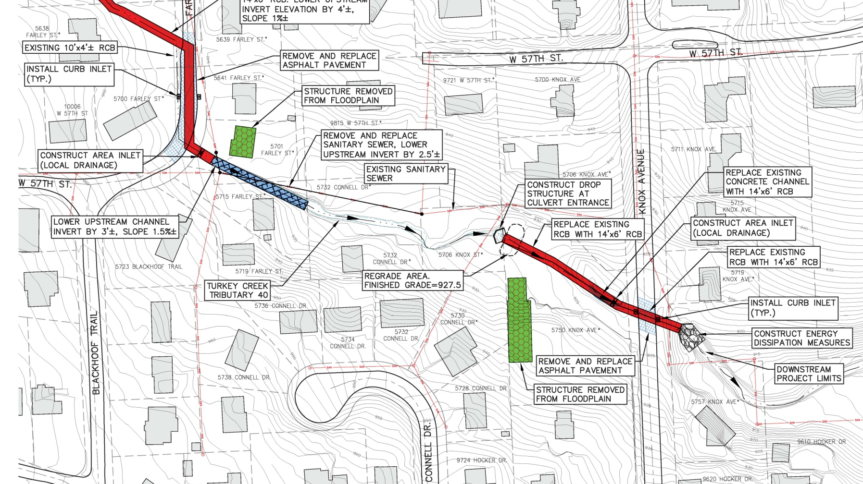
Preliminary Studies – Storm Drainage
Detailed Survey Data Not Required
Same level of accuracy as the Johnson County Watershed Studies
Significant Cost Savings

Slide 4
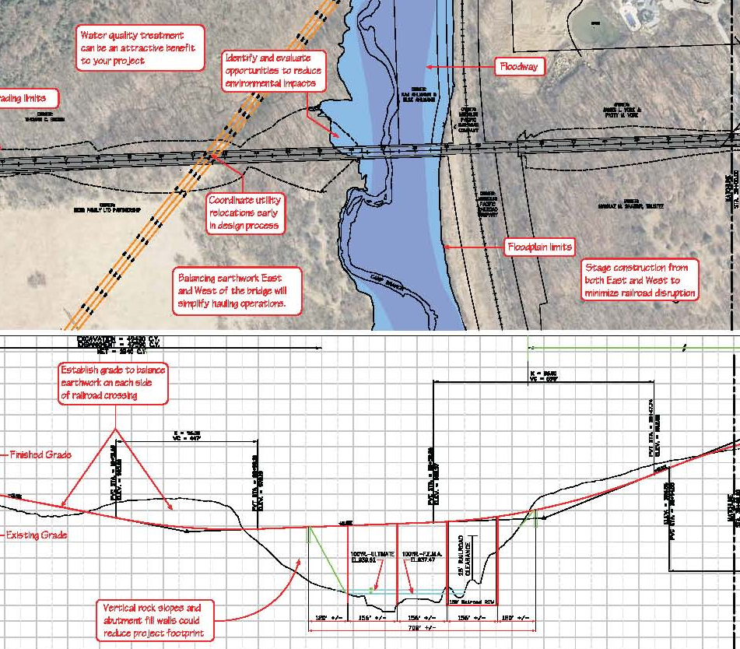
Preliminary Studies – Roadway
Detailed Survey Data Not Required
Determine the limits of impact for design alternatives
Significant Cost Savings

Slide 5
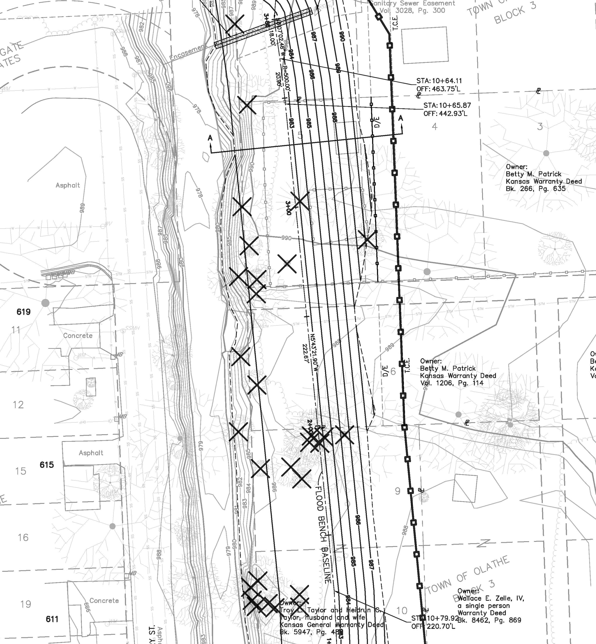
Design Project – Creek/Road
LiDAR supplements detailed survey data
Create a “blended” surface for work outside the detailed survey limits
Significant Cost Savings
Supplementary LiDAR Data
Limits of Detailed Survey

Slide 6
Design Project – Development
Survey key locations to verify accuracy of AIMS Data and supplement LiDAR with survey data
Adjust AIMS data if needed to design street, storm and sanitary sewer
Significant Cost Savings

Slide 7
FEMA Floodplain - Modeling
Use LiDAR DEM to estimate the watershed and runoff in the creek
Use LiDAR DEM to determine the shape of the channel
Significant Cost Savings

Slide 8
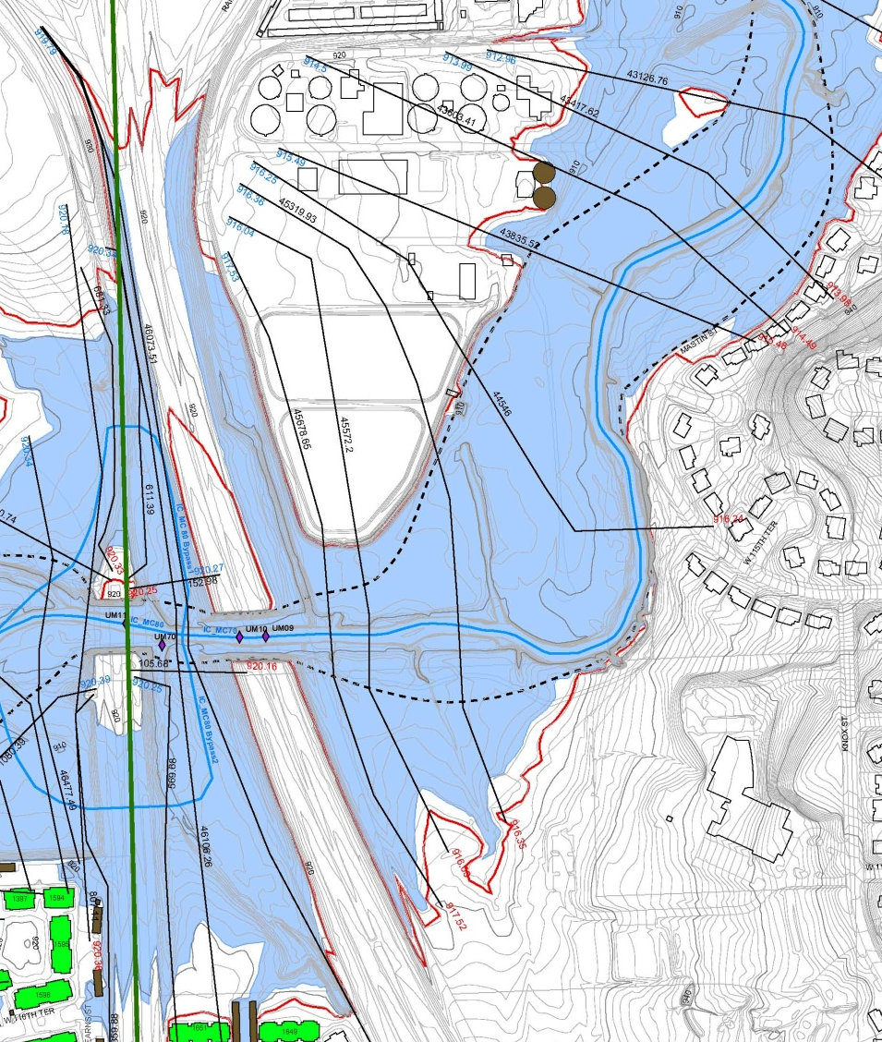
FEMA Floodplain - Mapping
Estimate depth of flow in Creek
Project on LiDAR DEM
Delineate Floodplain

Slide 9
Future Uses
Identify Areas of Topographic Change
  Stream Migration
  Development
  FEMA mapping updates
Determine areas at risk of slope failure
  Steep Stream Banks
  Overlay with soil shapefile to identify soils erosive soils
  Develop Stream Bank Stability programs/priorities
Countywide Master Planning
  BMP’s
  Sanitary Sewer
  Roadway Alignments

Slide 10
LiDAR Delivery Formats
For Use in GIS Analysis
  “Clean” DEM with no conversion by AIMS
  Typically for Watershed or County Wide Studies
For Use in AutoCAD Projects
  Convert “Clean” DEM to a Point Shapefile
  Text File with Only Northing, Easting and Elevation
  Does not require highly trained GIS personnel
  Typically for Design Projects

Slide 11
Using LiDAR Data for Engineering Projects
Discussion

