Slide 1
ArcGIS Online Focus Group Recap

Slide 2
What is ArcGIS Online?
Online mapping platform
Ready to use
Free content
Mobile ready
Secure
Scalable
Two types of accounts

Slide 3
How does it work?
Sign up
Create accounts/invite users
Set up groups
Add content
Start making maps
Service credits

Slide 4
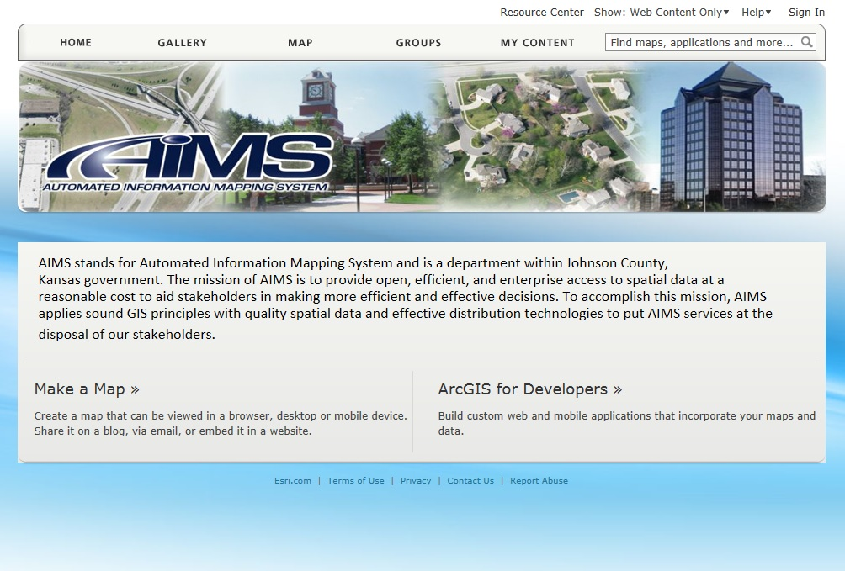
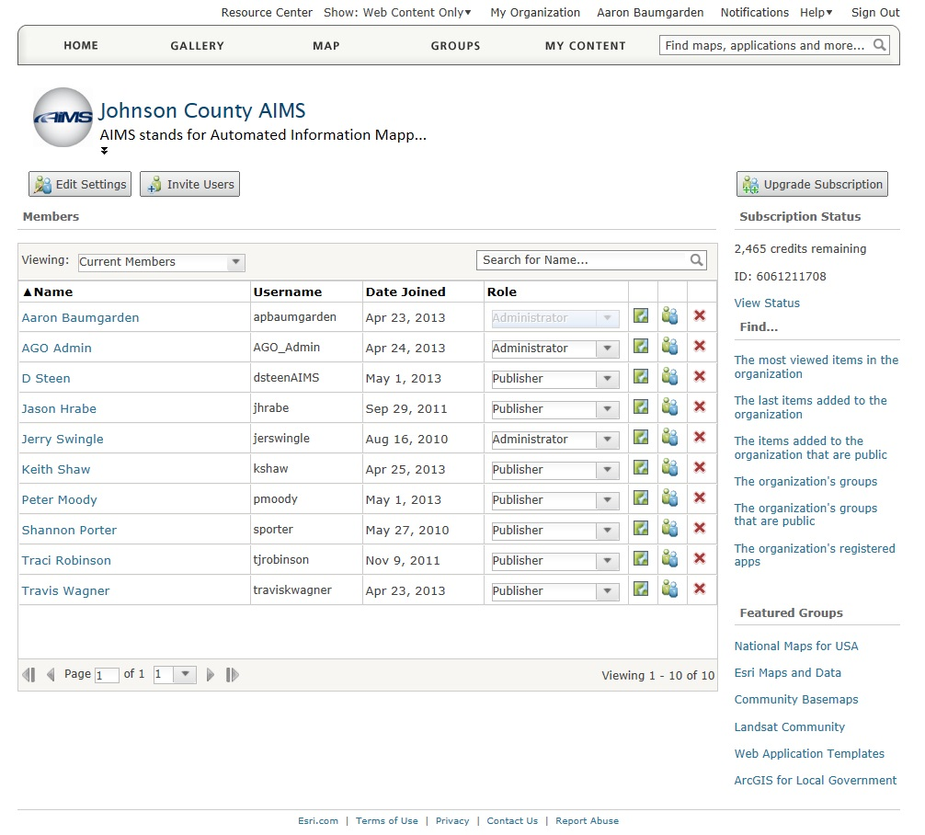
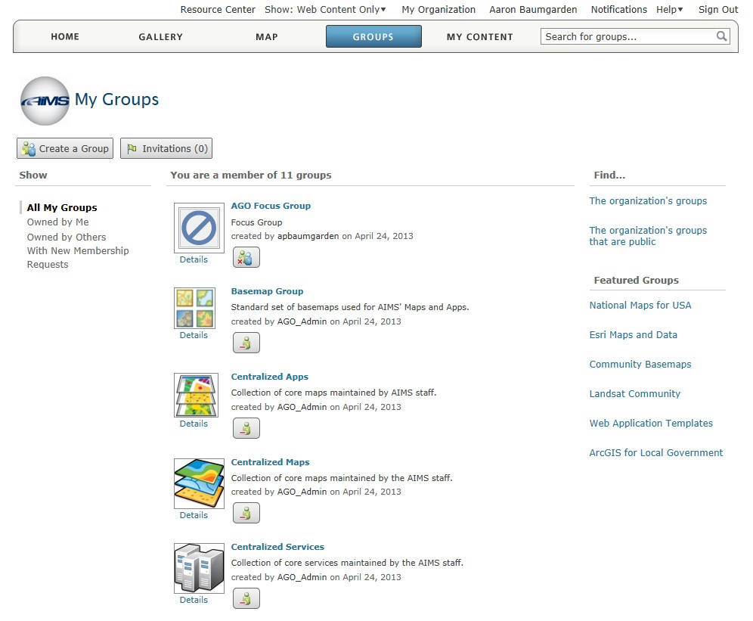

Slide 5
What the FG Covered
Setting up the account
Adding data to the map
Sharing content
Collector app (golf outing)
Operations Dashboard
Viewing live data
Notes:
The focus group began meeting at the end of March and met every 2 weeks through the beginning of June. During the first couple of meetings in March and April we covered a lot about how to set up your account and begin sharing data. We also looked at some example of how others throughout the region were using their accounts and the types of information they were sharing. If you happened to make it to the May Coordinators meeting at OP then you were able to participate in one of our first hands on workshops. OP also put together a simple application for field data collection to be used in conjunction with the golf tournament (Doug’s recap of the May meeting). The Collector app was used on IOS devices to gather the location of shot. The final two meetings were spent reviewing the Operations Dashboard and some of the available application templates.

Slide 6
What’s New
Spatial analysis tools
Summarize within
Summarize nearby
Drive-time areas
Find nearest
Merge layers

Slide 7
What’s New
Improved imagery display
Show tables
Create filters
Display legend (Server 10.2)

Slide 8
What’s New
New story map template
http://storymaps.esri.com/home/

Slide 9
What’s New
Enhancements to enterprise logins
No longer beta version
Users with enterprise login can be invited to join organization
Help

Slide 10
Discussion
Doug Hemsath
Stormwater project
Doug Johnson
Dashboard demo

Slide 11
Q&A

