Slide 1



Testing hair follicle strength in young adults
A study of male pattern baldness associated with testing Esri’s Schematics extension.

Slide 2
Just Kidding!

Slide 3
Schematics for Transit
Updating your system map.

Slide 4
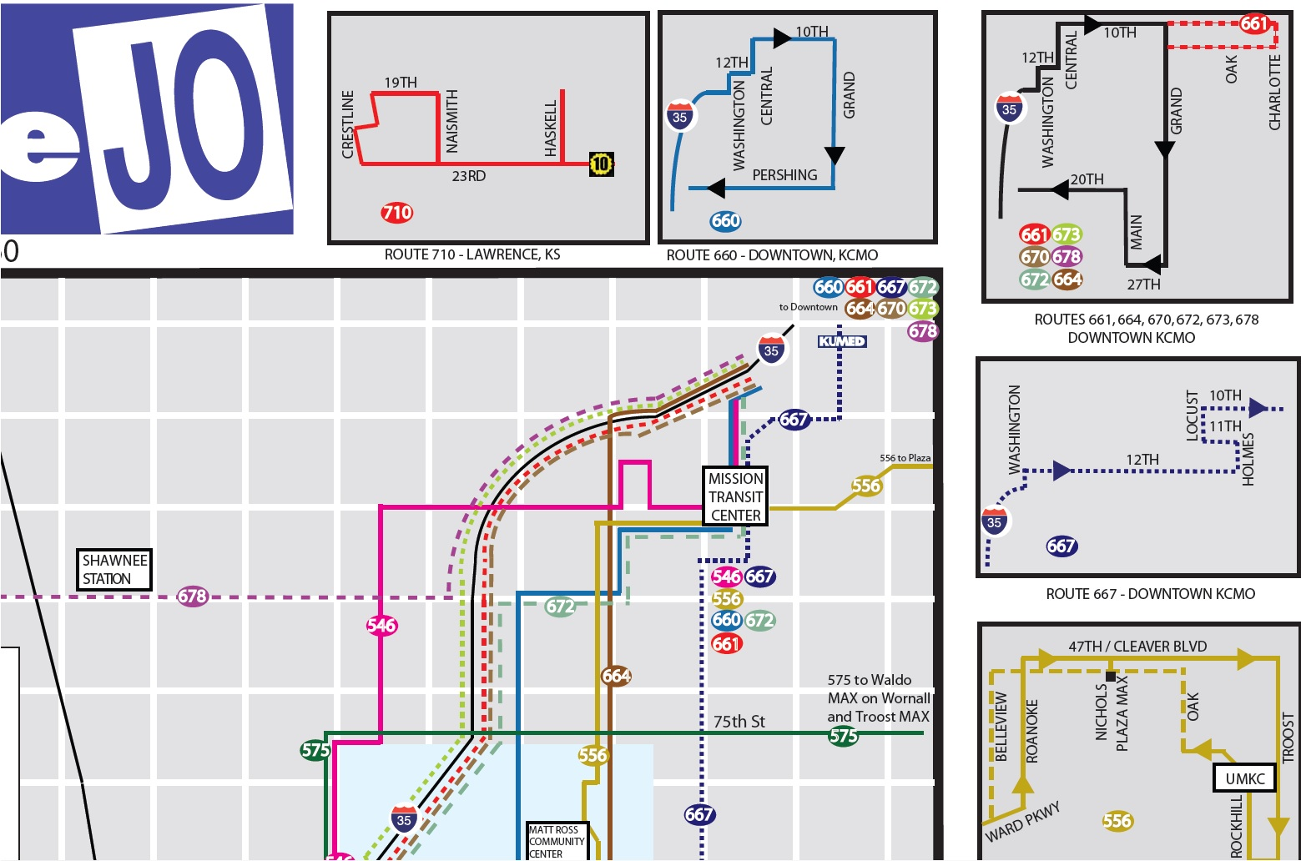
System Map (before)

Slide 5
Research
Designing printed transit information materials guidebook – Ctr. For Urban Transportation Research (USF)
Cartography blogs
Graphic design blogs

Slide 6
Options
Continue working in Illustrator
Generate representations
  Produced odd results
  Offsets entire line, not just those overlapping
Manually create offset lines
  Too time consuming
  Accuracy concerns
Outsource
Schematics

Slide 7
What is Schematics?
Automatic representation solution
Works with any network data
Visualize linear physical and logical networks
Dynamically check connectivity in any network
Sounds great, right?

Slide 8
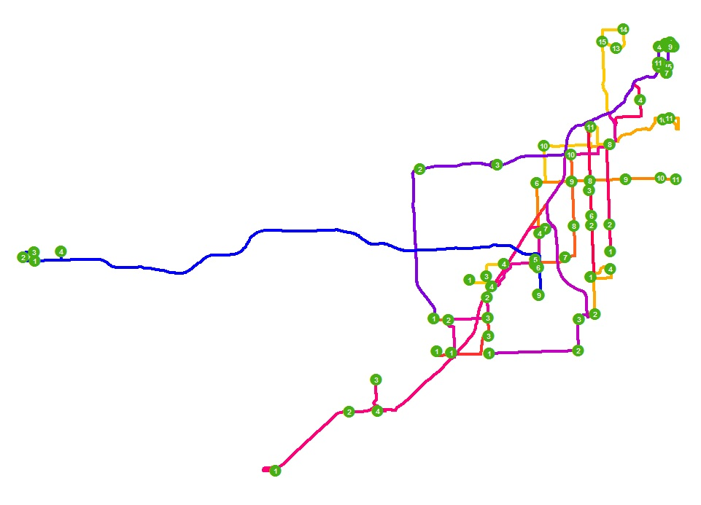
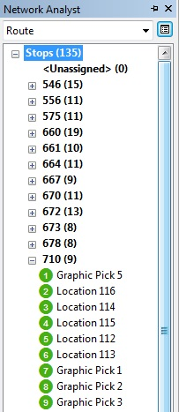
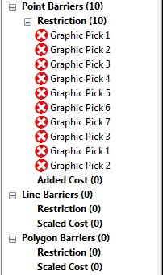
Setup

Slide 9
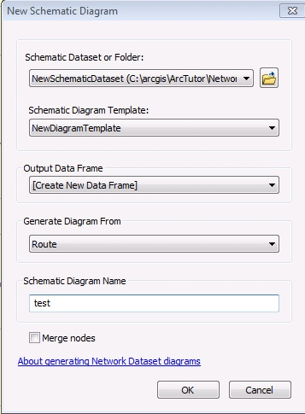
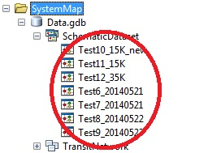
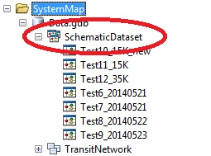
Creating a Schematic Diagram

Slide 10
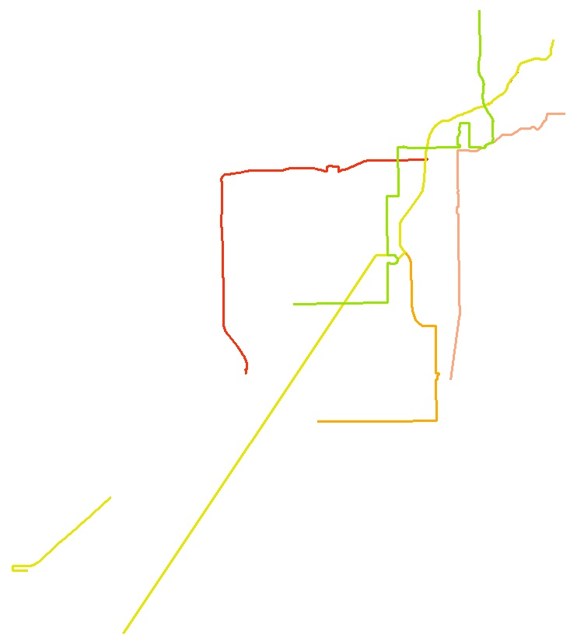
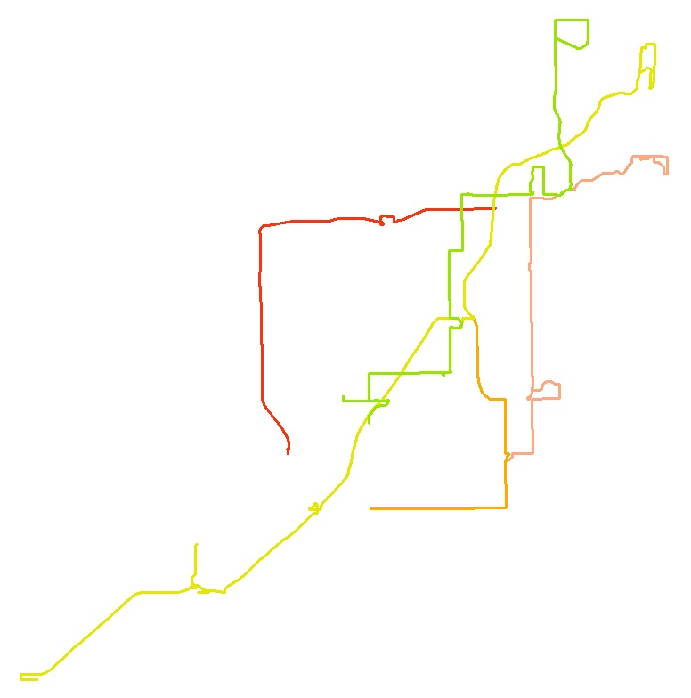
Testing

Slide 11
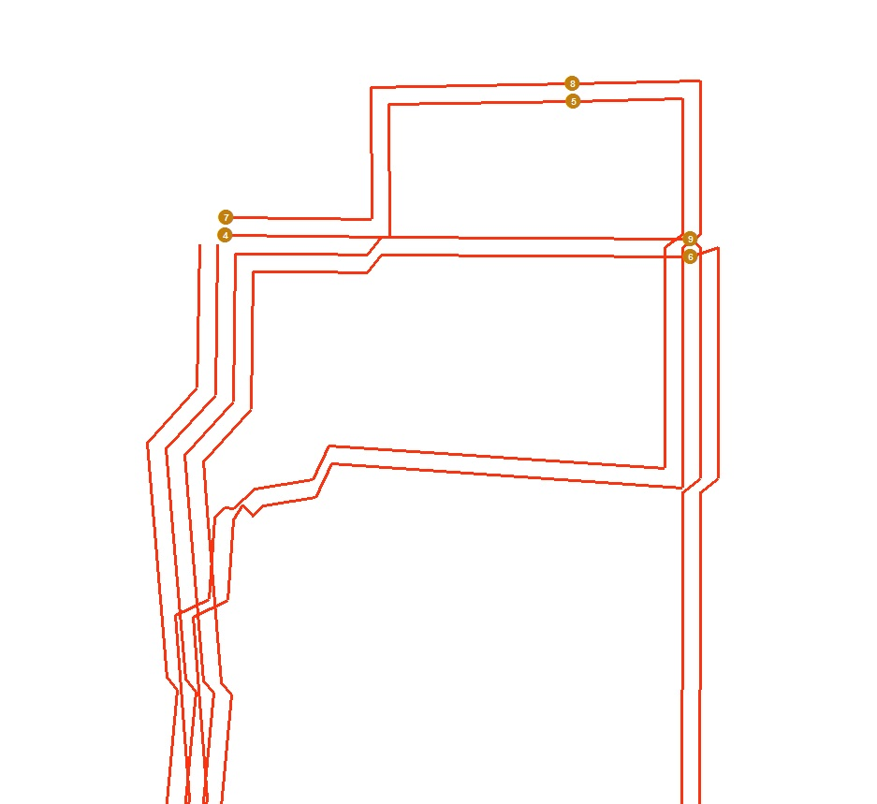
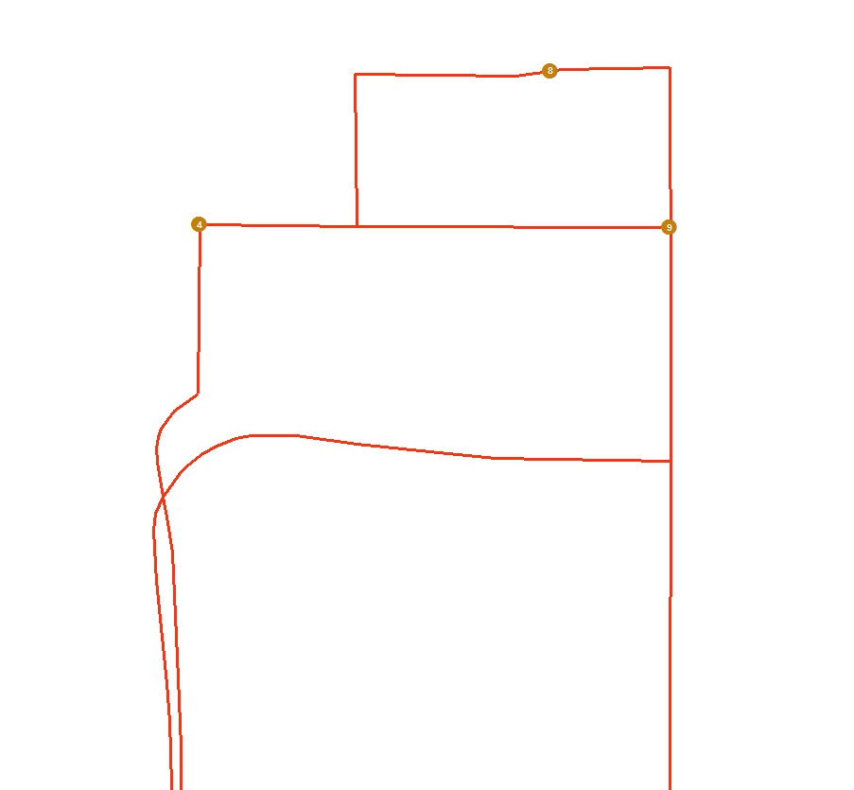
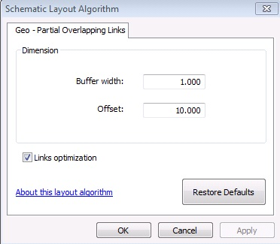
More Testing

Slide 12
Issues
No “loops” or large edge features
Works best with output from Network Analyst – multi-route solver
Route # doesn’t export to diagram
Stops need to be outside buffer dist.
80-20 method

Slide 13
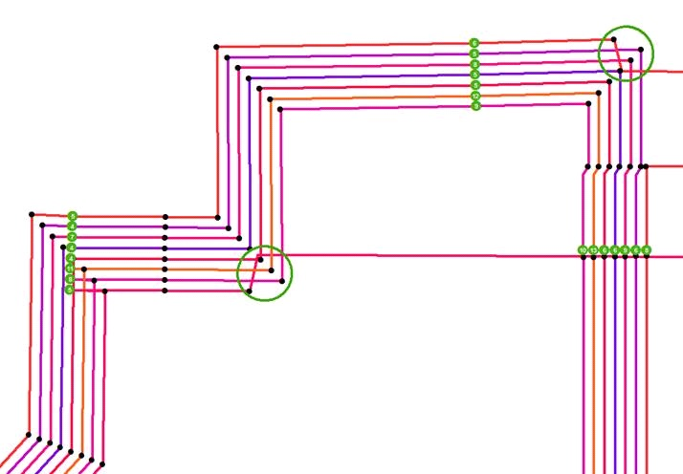
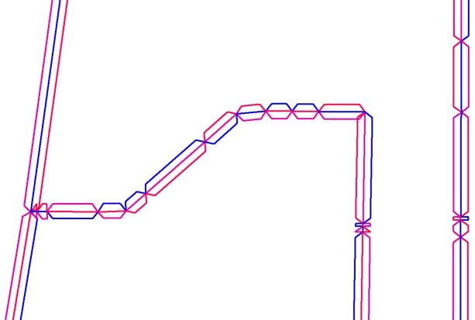
Issues cont’d

Slide 14
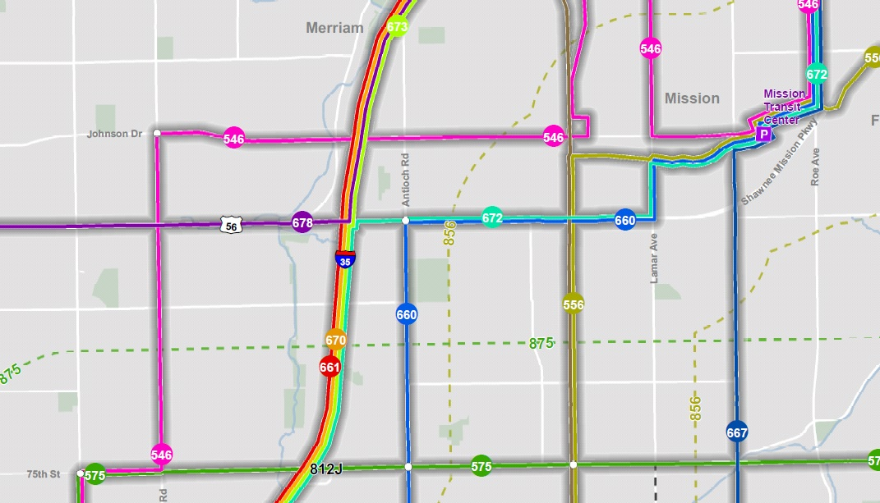
System Map (after)

Slide 15
Conclusion
Schematics does work!

