Slide 1
Next Generation 911
Update

Slide 2
Imagery
1 foot resolution WMS is available now
To request the imagery, please click on the following link:
http://www.kansasgis.org/initiatives/NG911/imagery.cfm
DASC will provide you with a security key
AIMS has a layer available for this if you want to hit our site

Slide 3
The State Project
Remediation
Changes
We have the QC information from the state and are currently remediating the errors.
Addresses
Centerline
Boundaries

Slide 4
Addresses
LocType | Count
Street Light Controller | 582
Electrical Service | 508
Sprinkler | 422
Electric Meter/Power Supply | 322
Car Port | 263
Camp Site | 199
Other | 178
Sign | 177
Water Meter | 157
Monument Sign | 152
Utility Box | 140
Land Disturbance | 119
Signal Controller | 115
Utility | 115
Tract | 96
Traffic Controller | 91
Electrical Box | 90
Electrical | 55
Lift Station | 45
Gas Service | 42
Storm Siren | 40
Storage Tank | 31
Communication Tower | 30
Flashing Beacon | 29
Ball Field | 24
RR Signal | 20
Traffic Signal | 17
Water | 16
Cell Tower | 14
Park | 14
Billboard | 9
Building Shell | 9
Warning Siren | 8
Parcel Tag | 7
Railroad Crossing | 7
theJO Bus Service | 7
Fence | 4
Government Olathe Parks & Recreation | 4
Temporary Trailer Construction | 4
Carrier Station | 3
Batting Cage | 2
Flood Warning | 2
Job Trailer | 2
Oil Storage Tank | 2
Park Electric Meter | 2
Shell Address | 2
Water Tower | 2
Air Quality Monitoring Site | 1
ATM Machine | 1
Garage | 1
Storm Sewer Interceptor | 1
Temporary Monument Sign | 1
Trash | 1
Utilities Electric | 1
“Other” addresses
  We have modified the nightly address process to include the other addresses collected by the cities. Things like electrical boxes, or street light controllers help with matching telephone number lists.

Slide 5
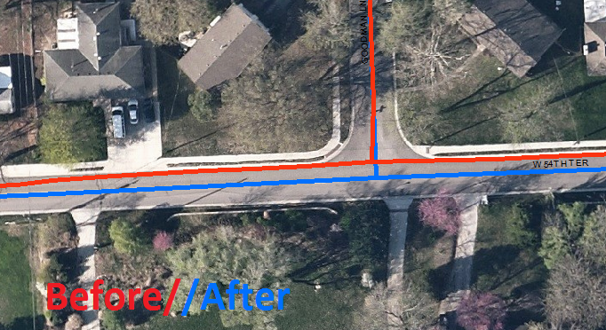
Centerline
Placement
Divided Road

Slide 6
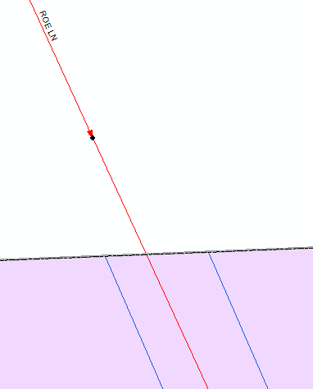
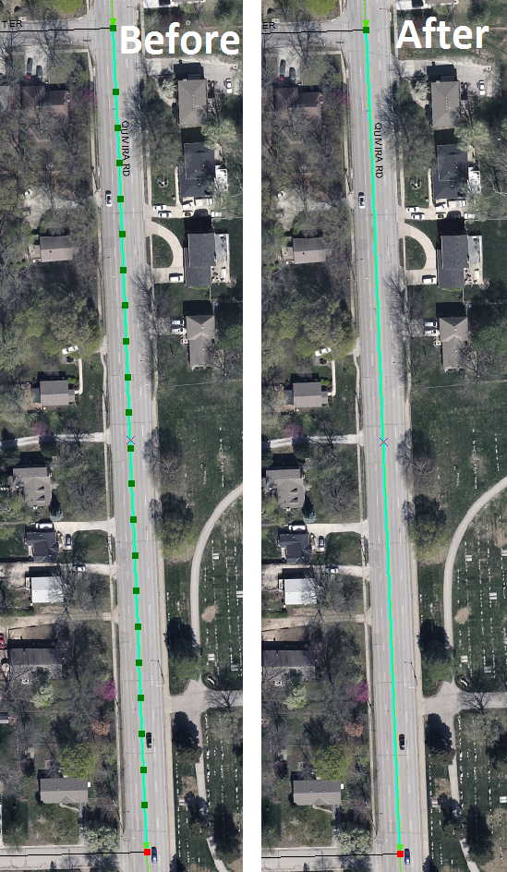
Centerline Edits
Extra Fields? # of lanes

Slide 7
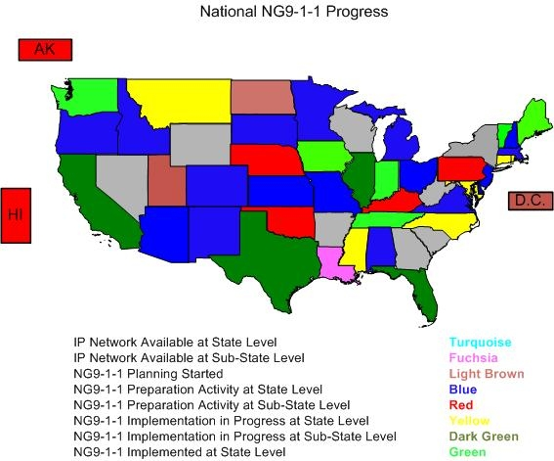
National NG911 Progress
As of 8/5/2014

