Slide 1

PFI Update

Slide 2
PFI Goals
    Improve spatial accuracy of the tax parcel data
    Develop and enhance our methods, procedures and skillsets in tax parcel mapping
    Establish the highest level of confidence in our tax parcel data

Slide 3
Parcel Mapping Techniques
Legal descriptions
  Metes and Bounds, Aliquot Parts (PLSS), lot/block system (subdivision) and strip description
Older Plats
  Sometimes they have a few Metes and Bounds calls and maybe even a reference to PLSS
  Most of the time they call boundary dimensions and Right-of-Way widths
Newer Plats
  Mostly metes and bounds calls and good reference to PLSS
Fractional Sections
  Protraction of lines and corners

Slide 4
PFI Goals
Parcel Foundation Initiative
Spatial Accuracy, Methods and Procedures
Goals
Spatial Accuracy, Methods and Procedures (Confidence in Parcel Data)
Daily Parcel Editing
Spatial Accuracy, Methods and Procedures

Slide 5
Comprehensive Approach
    Establish spatial control at the section level in the PLSS
    Create parcel lines using the deed legal description with supporting data sources
    Incorporate spatial accurate parcels into existing Parcel layer

Slide 6
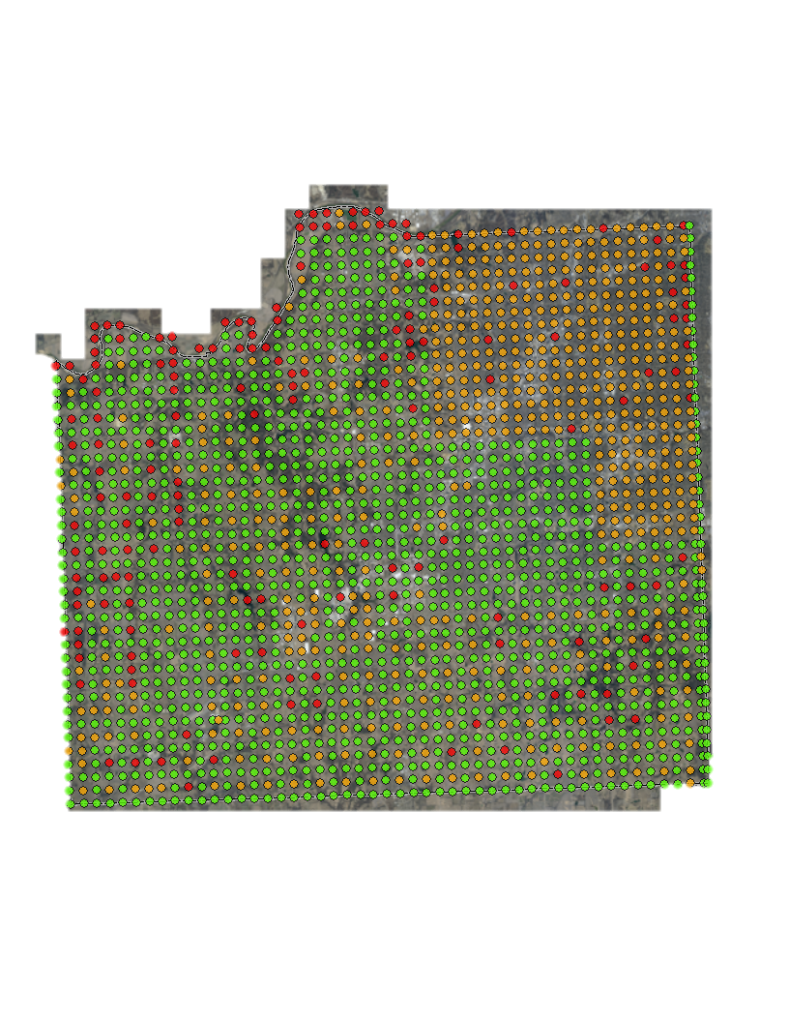

Slide 9
PFI Progress Notification
From: mapper@jocogov.org [mailto:mapper@jocogov.org]
Subject: Parcel Foundation Initiative Progress
There were 2 sections integrated yesterday. The sections integrated are X03,N22. See the attached map or to view them in AIMS Online Mapping click the link (http://maps.jocogov.org/ims/?z=11&ll=38.898381,-94.83175&op=0.5&ls=ay,bq&bm=3&sf=Districts/MapServer/50!Mapno!X03|Districts/MapServer/50!Mapno!N22). If you have any questions or concerns please contact the Records and Tax Administration Office at 913-715-0775 or AIMS at 913-715-1600. Thanks.

Slide 10
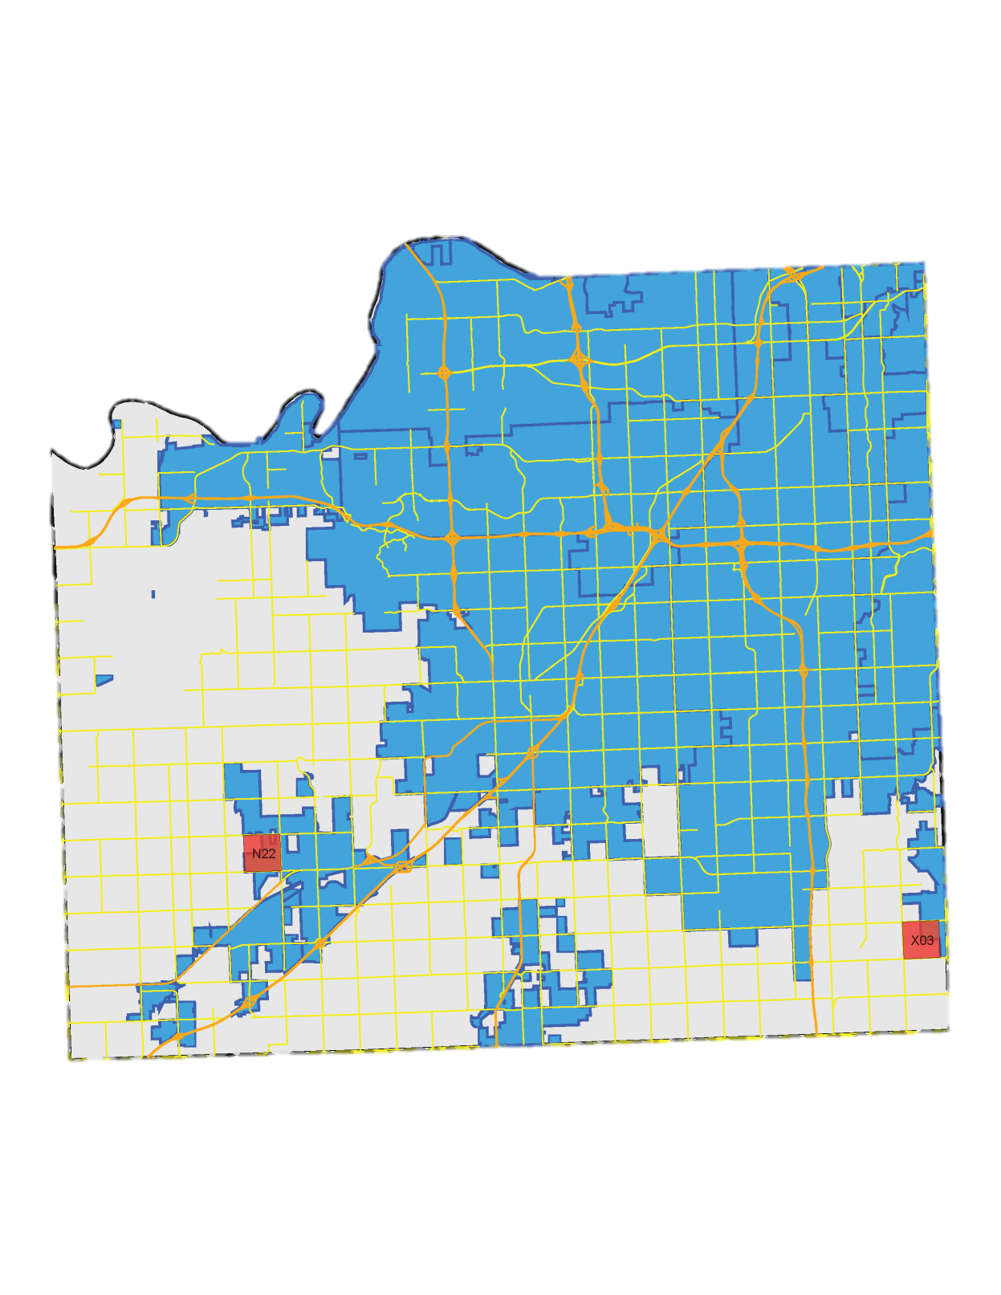
PFI Progress Notification

Slide 11
PFI Progress Notification
All Active Internal AIMS Users
cmuller@cityofshawnee.org
David Knight
DHemsath@cityofshawnee.org
diane.wicklund@jocogov.org
doug.johnson@opkansas.org
drose@waterone.org
fred.sherman@westwoodks.org
jeffrey.malotte@jocogov.org
jpaa@gardnerkansas.gov
karen.miller@jocogov.org
Kate Kennedy
kcook@edgertonks.org
keidson@waterone.org
Kevin Skridulis
mhockensmith@waterone.org
mike.nelson@opkansas.org
pamela.hayhow@jocogov.org
Paul Null
paul.greeley@jocogov.org
Terrol Palmer
tim.fitzgibbons@opkansas.org

Slide 12

Terrol Palmer
Terrol.Palmer@jocogov.org
GIS Developer II
Department of Records and Tax Administration
111 S. Cherry Street, Suite 1200 Olathe, Kansas 66061
Direct (913) 715-2328 | FAX (913) 715-0800
Office (913) 715-0775 |TDD 800-766-3777

