Slide 2
2017 Values
Commercial Values released
February 14th
Residential Values Released
February 28th

Slide 3
2017 Values
Appraiser’s Revaluation Report
https://www.jocogov.org/dept/appraiser/publications/revaluation-report
https://www.jocogov.org/sites/default/files/documents/APR/2017_Reval_Report.pdf

Slide 4
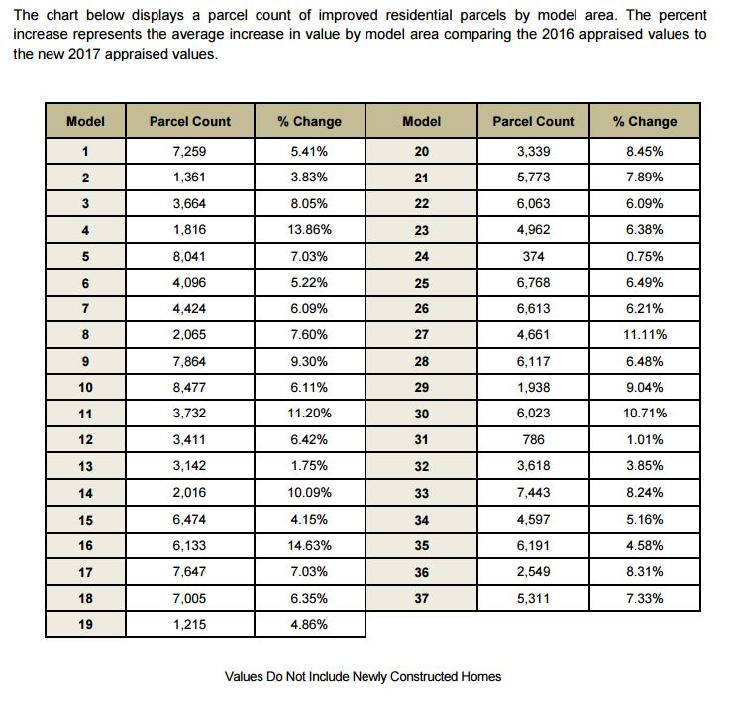
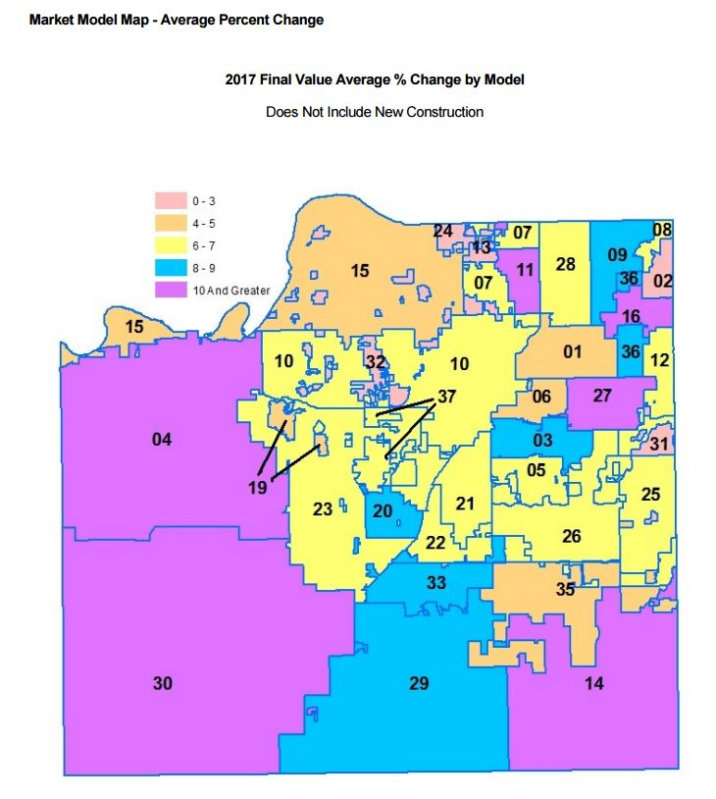
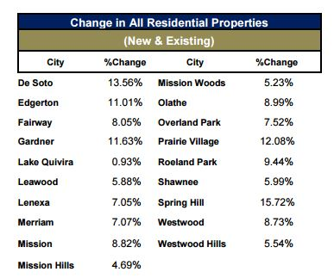
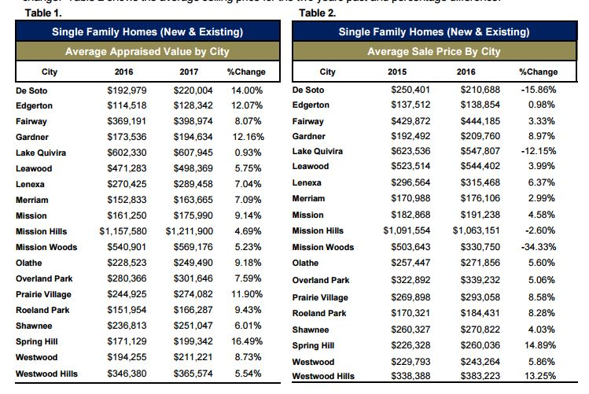
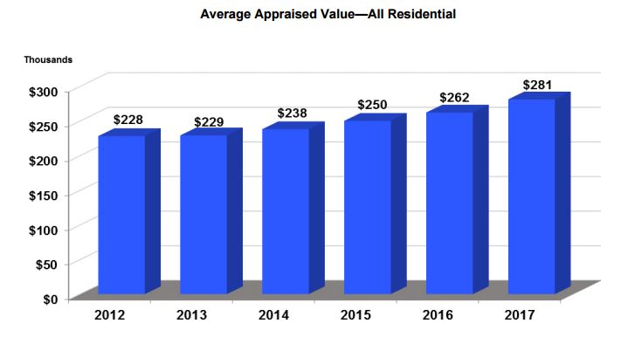
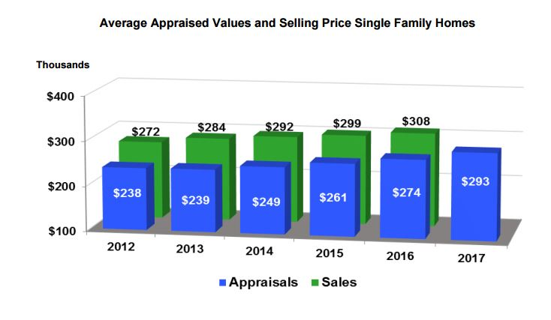
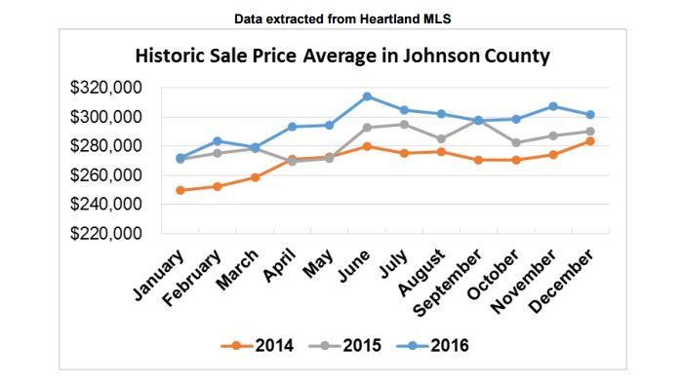
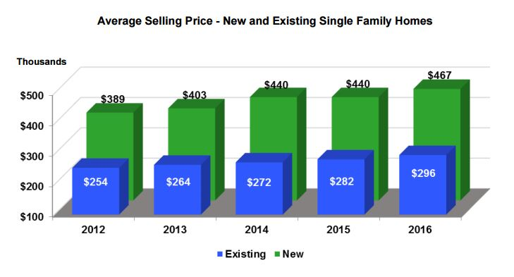
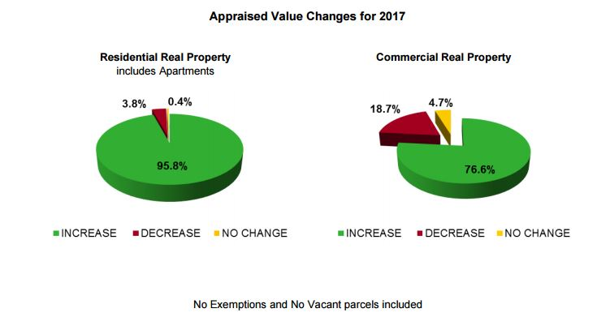

Slide 5
More Granular
AIMS Feature Classes In jocoPub
PropertyValueHistory_PT
PropertyValueHistoryFlat_PT
Property_PL_vw14
Property_PL_vw15
PropertyCAMAUpdateSince170213_PT
Subdivision_PL_vw1

Slide 6
Density Layer
AIMS Feature Classes In jocoPub/jocoArchive
Property Value Density
SnglFam & SnglFam(TaxYear)
MultFam & MultFam(TaxYear)
Res & Res(TaxYear)
Comm & Comm(TaxYear)
Comp & Comp(TaxYear)

Slide 7
ArcMap Demo
AGO Demo

