Slide 1
AIMS use of Lidar

Slide 2
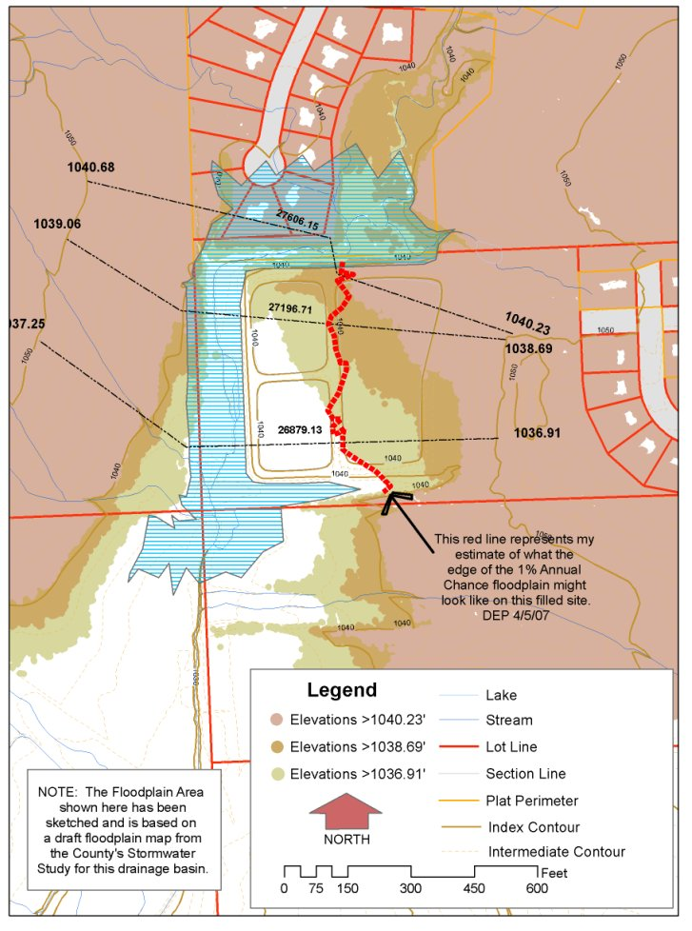
Primary uses
Contour creation
DTM/DSM generation
Ortho photo rectification
Floodplain determination

Slide 3
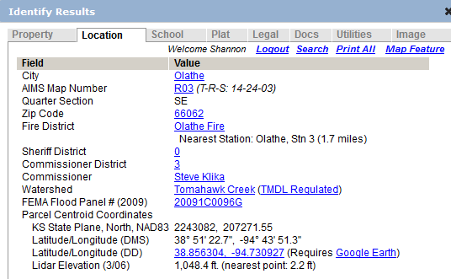
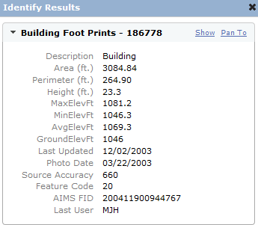
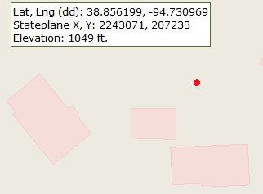
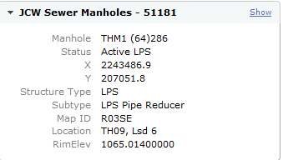
Secondary Uses
Building height estimates
Height returned via IMS on point and parcel
Assignment of elevation to sewer manholes

Slide 4
Unusual uses
Historic trail identification
citizen was able to determine the elevations in an area and suggest alternative higher locations for a proposed cell tower
Stormwater trace
“Change detection” difference
Vegetation/Tree Canopy identification

Slide 5
Veg Replacement Options
Heads up digitizing/updating of existing
Use of feature analyst
Infrared – usually leaf off
Use of Lidar analyst
Use of classification
Use of height differences
Use of return number
Use of LAStools

Slide 6
Preview of veg
LAS To Multipoint
Aggregate Points to Polygons
Cleanup – dissolving, simplifying, removing spikes, smoothing, etc.
QC

Slide 7
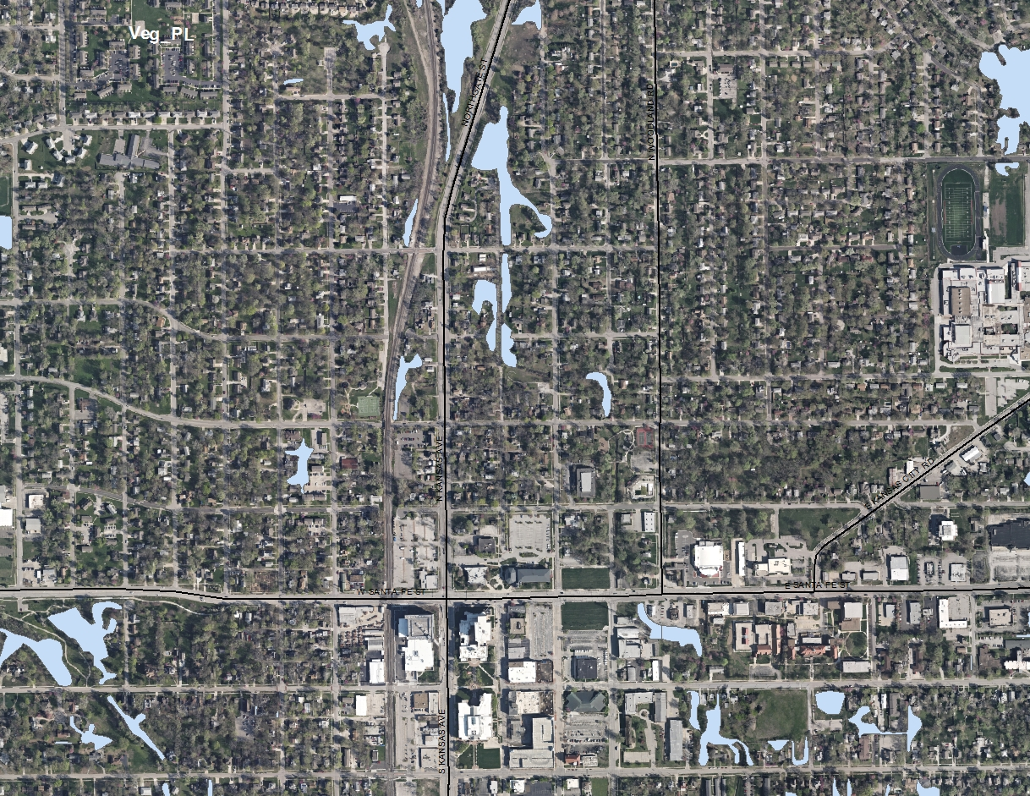
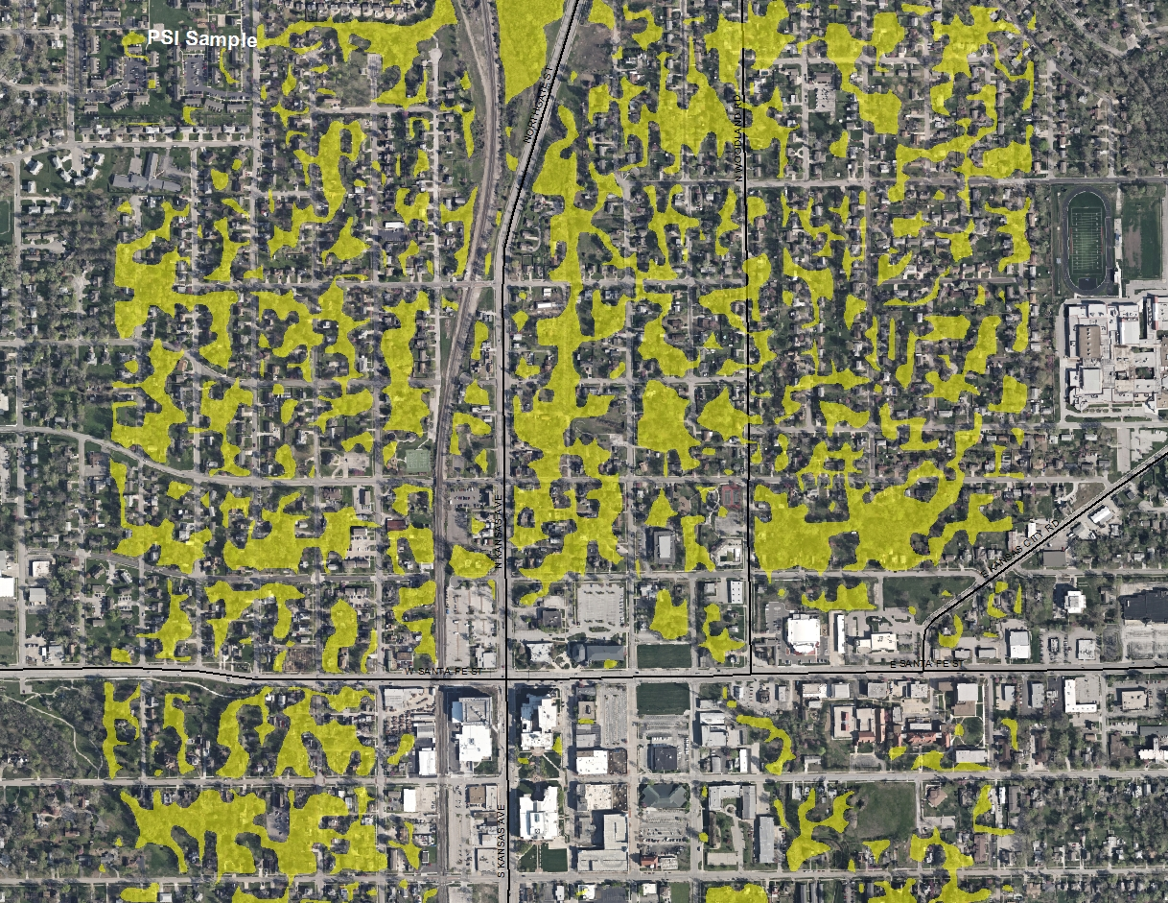
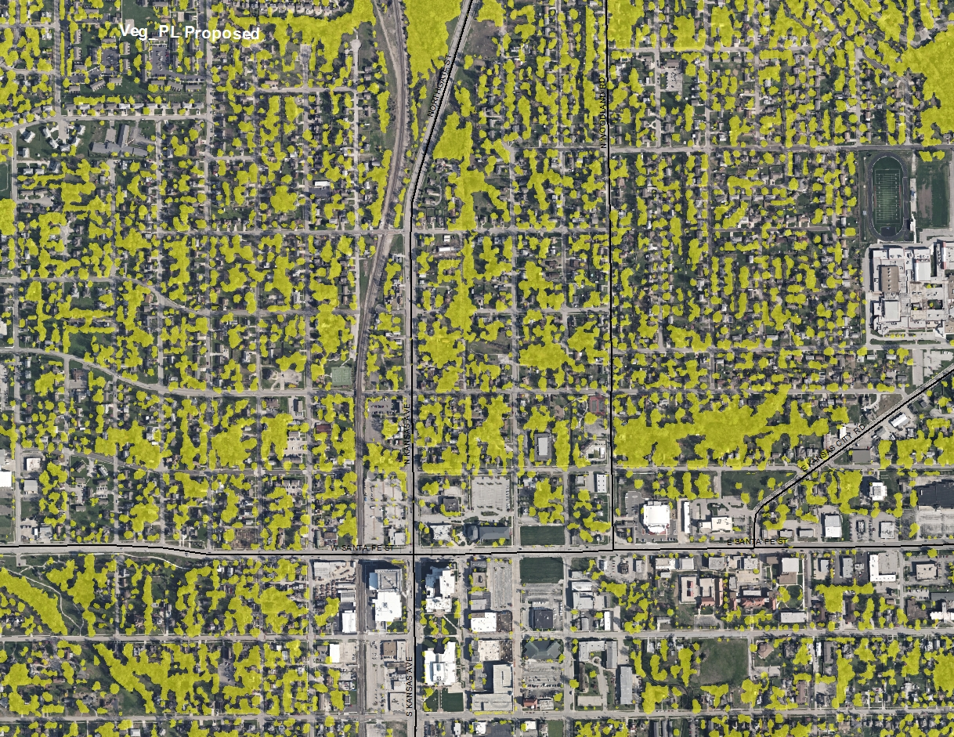

Slide 8
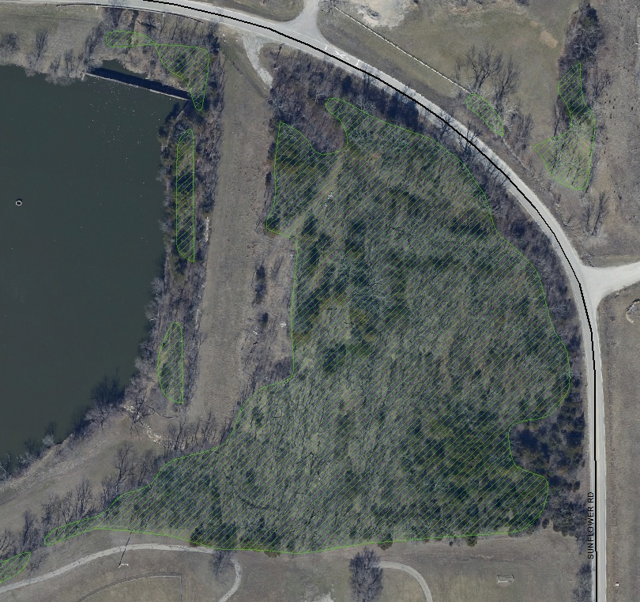
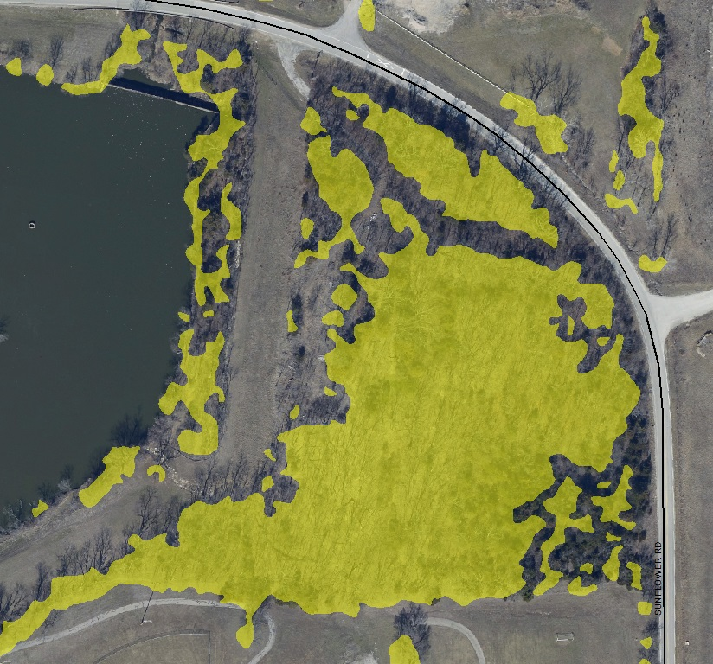

Slide 9
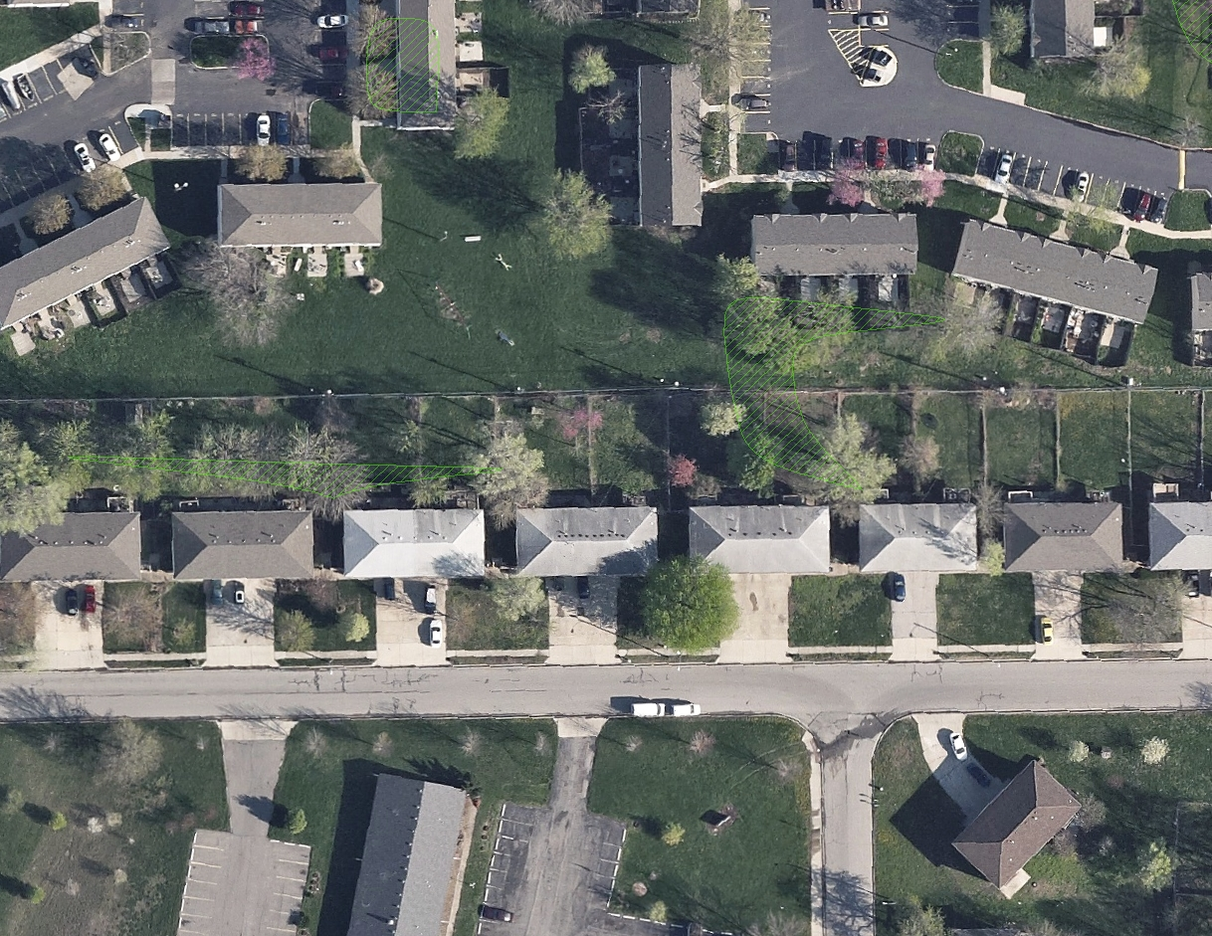
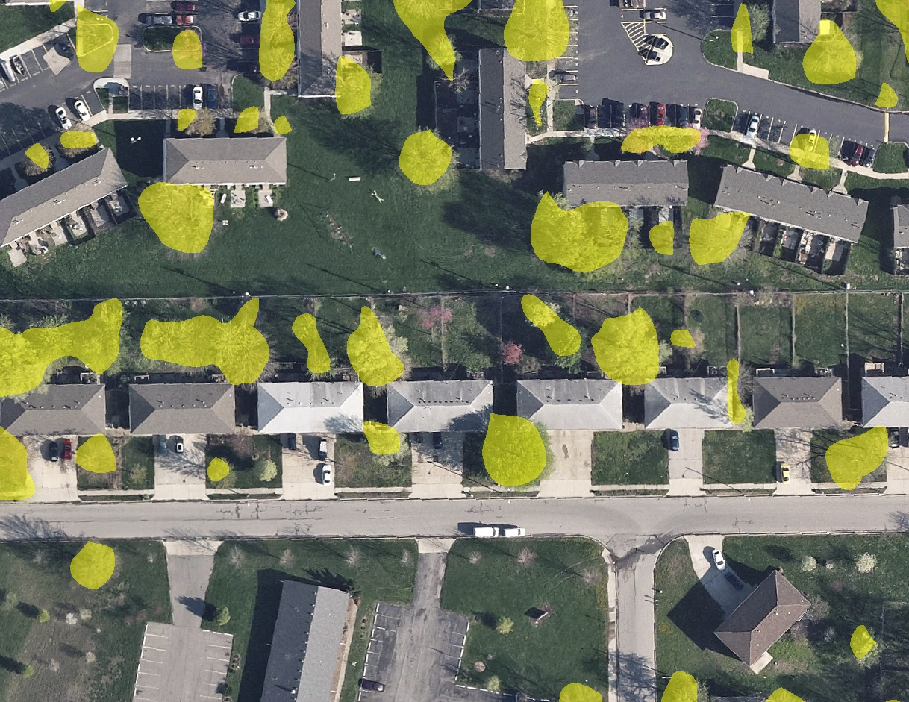

Slide 10
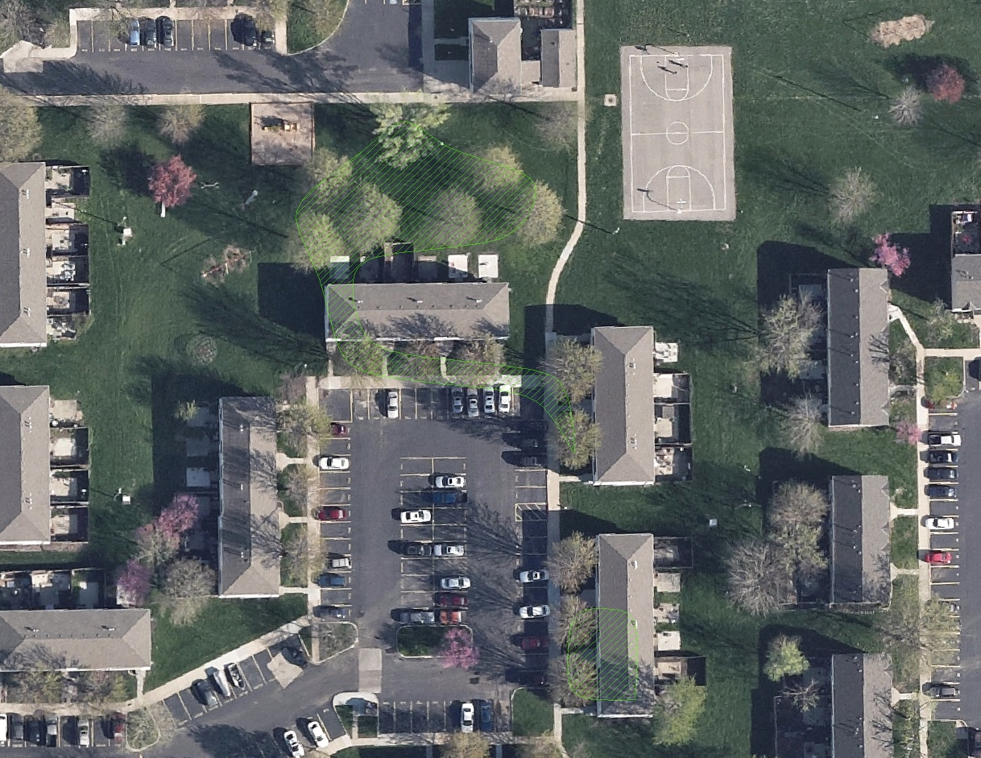
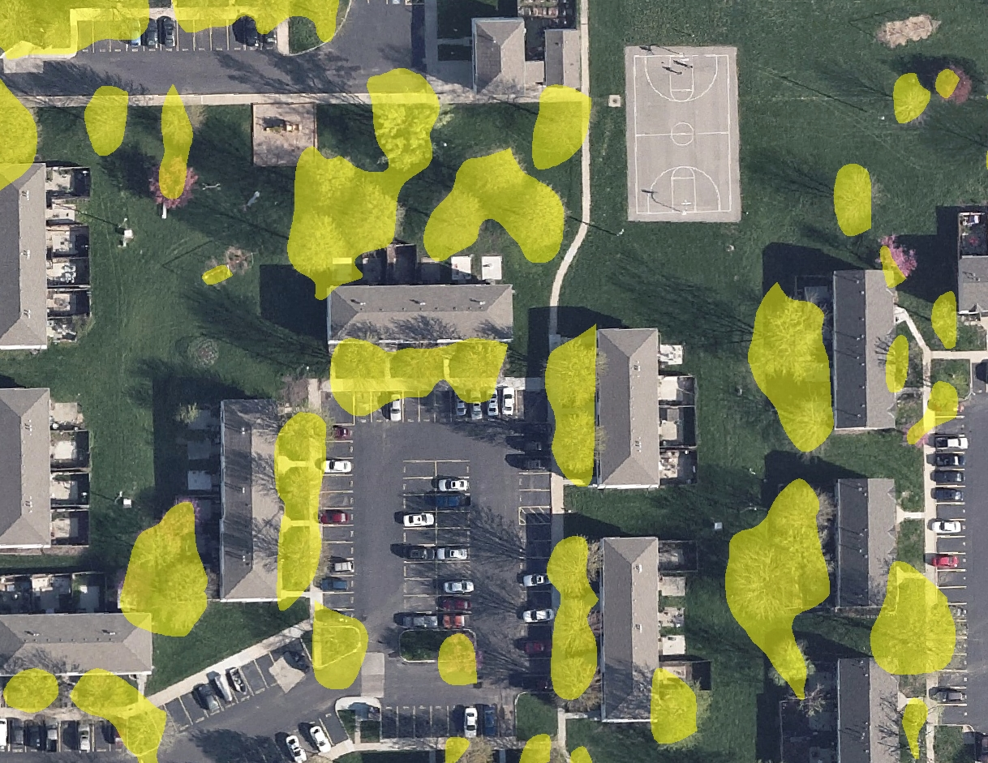

Slide 11
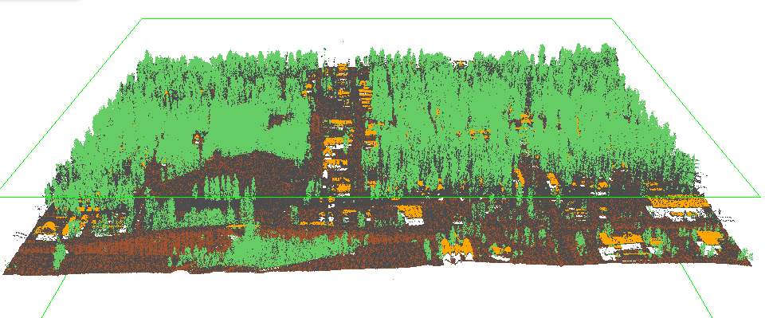
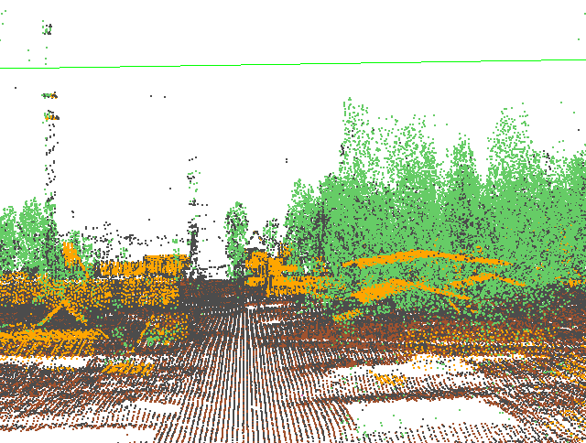
Tools to be aware of
http://www.Lastools.org

Slide 12
Tools to be aware of
http://resources.arcgis.com/en/communities/3d/

Slide 13
Other ideas
Classify bldg and veg points in LAS
Solar potential utilizes aspect
Line of sight analysis
Terrestrial Lidar – purchased by Crime Lab?
Mobile Lidar – useful for street inventories

