Slide 1
Emmitsburg ReCap
Our trip to IEMC
Integrated Emergency Management Course

Slide 2
Overview
What was it?
A 4 day training course offered by FEMA to test the validity of the county Emergency Management plan.
Who was there?
73 people from
21 County Departments
18 Cities
13 Other entities
What did we cover?
What GIS specific problems did I see?
How can we improve in the GIS realm?

Slide 3
What did we cover?
National Weather Service
Emergency Management Practices
The State’s Role
Public Policy
ICS application
Public Safety Agencies
Situational Awareness
Public Information
Stress Management
Public Works
Short-Long Term Recovery
Community Services
Federal Assistance Programs
Some Highlights
NWS is broken
This is REAL
75%/25%
Protective Diamond
Social Media creates news
50% PTSD
DPW is an emergency service

Slide 4
What GIS specific problems did I see?
Communication
GIS can not create itself
Sharing
GIS is worthless if it isn’t seen by people who need it
Application Deficiencies
Speed and Flexibility
Overload
You can not multitask in a disaster situation

Slide 5
How can we improve in the GIS realm?
We have to get the data in quickly and get the analysis out even quicker
It doesn’t do any of us any good to have silos
Everyone should be familiar with and use WebEOC simply because it is the communication application of choice
We need more specific training

Slide 6
Conclusion
In the end, it is all relative
Everyone needs a little personal security

Slide 7
USNG
United States National Grid

Slide 8
What is it?
The USNG is a point and area reference system that can describe a position or area of operations when and where conventional location references like landmarks or street signs are not in place, such as after a hurricane, flood, or tornado.

Slide 9
What can it be used for?
Search and Rescue
Tiling (gridding an area)
Pre-incident Planning
Operational Progress and Standardized Situation Reporting
Dispatch Functionality and Interoperability

Slide 10
Definition
The USNG uses a string of up to 15 characters to describe a precise location.
A USNG coordinate is divided into three components and is read like this:
the first three characters are a combination of two numbers and a letter representing a Grid Zone Designation (GZD);
the next two alphabetical characters represent a 100,000 meter (100 kilometers or 100K) square;
the remaining portion is entirely numeric and will always have an even number of digits. This portion is based on standard X and Y (Easting and Northing) coordinates of the UTM coordinate system, which is in meters.

Slide 11
A Sample
15S – Grid Zone Designation
UD – 100,000m Designation
42130 – read from left of origin
05192 – read from bottom of origin
15S UD 42130 05192 – 1m designation for the Admin Building

Slide 12
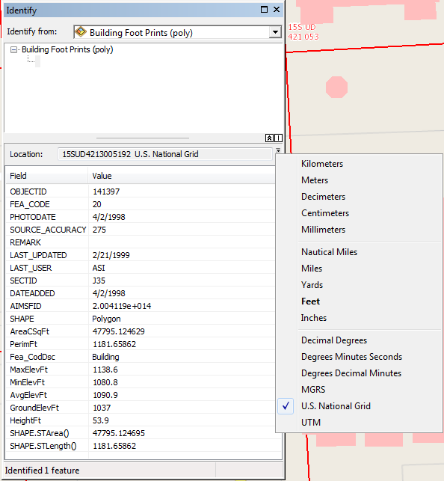
Where did I get that?
ArcMap of course

Slide 13
How to see it?
ESRI Map Service

Slide 14
What should we do with it?
Add it to point feature classes as an attribute?
Add the grid to our maps?
Produce mapbooks based off of the grid?
Anything?

Slide 19
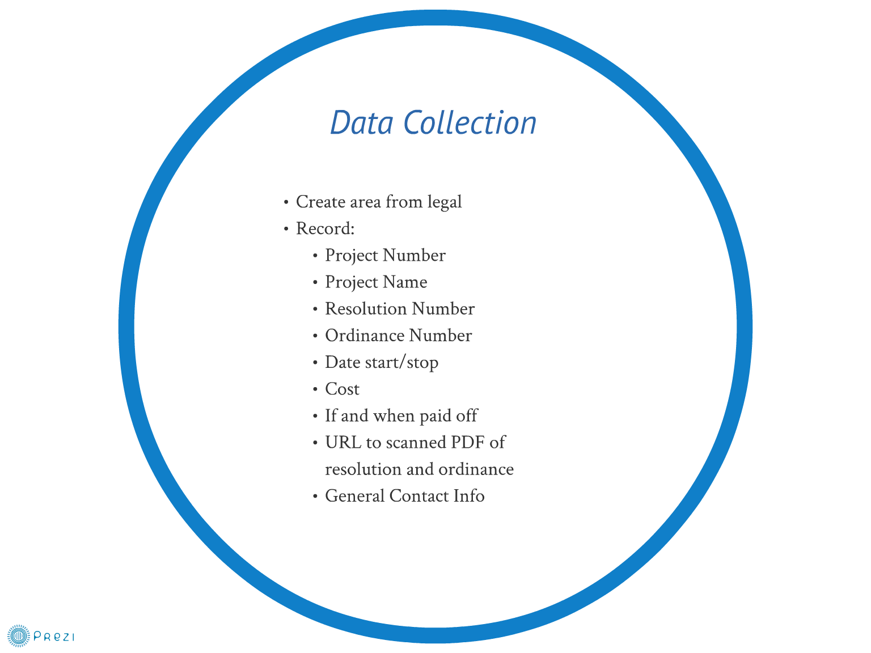

Slide 20
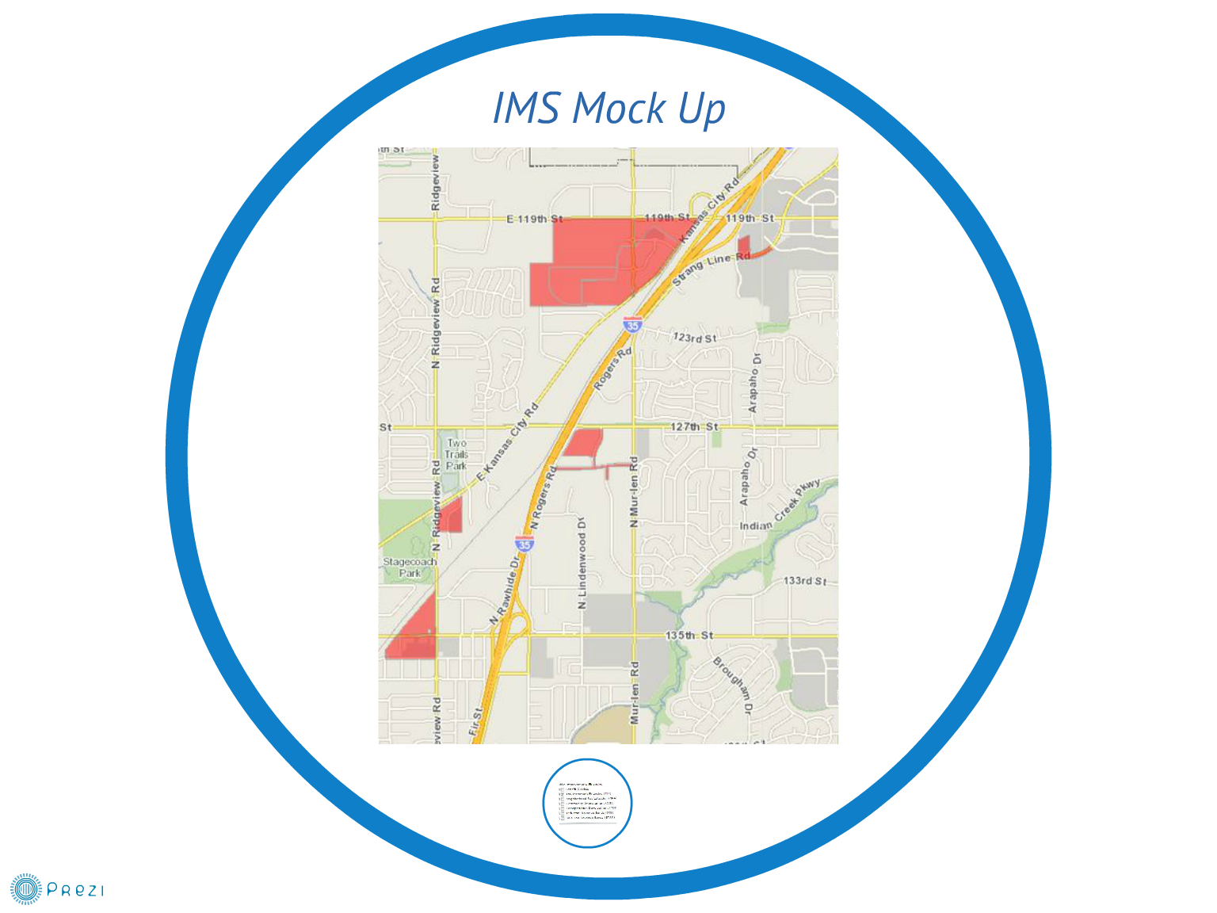

Slide 21
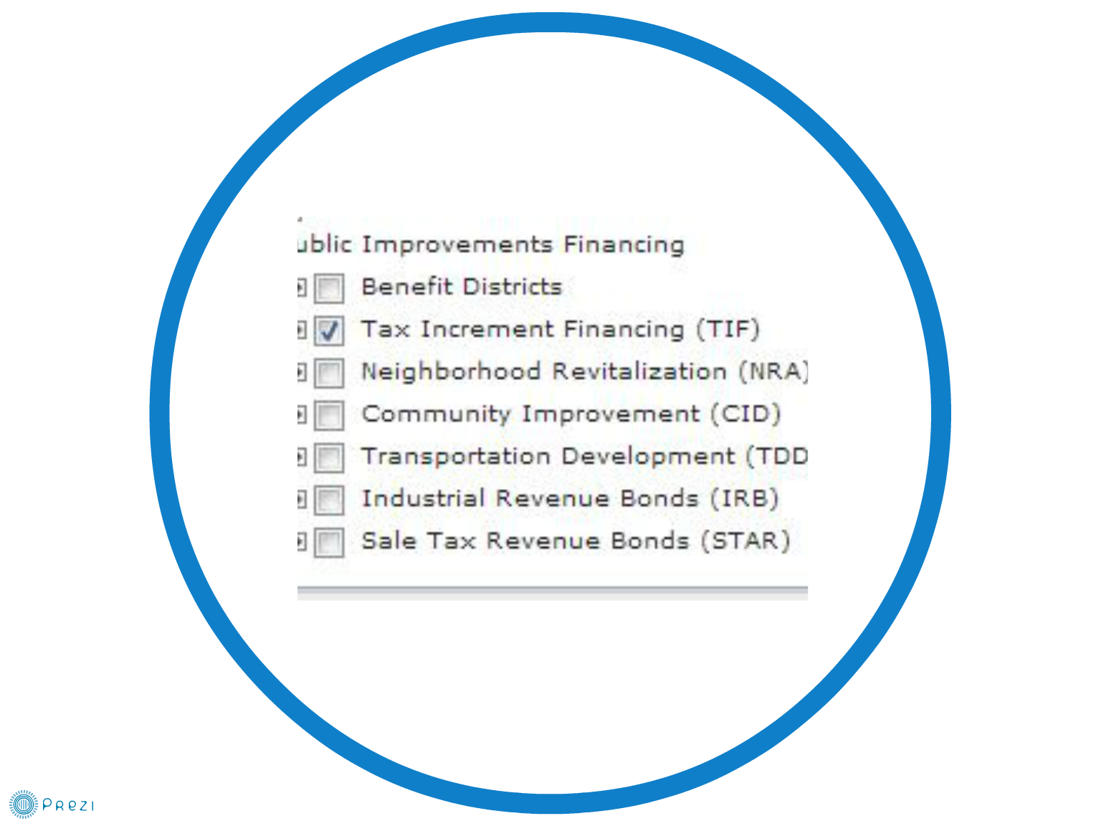

Slide 22
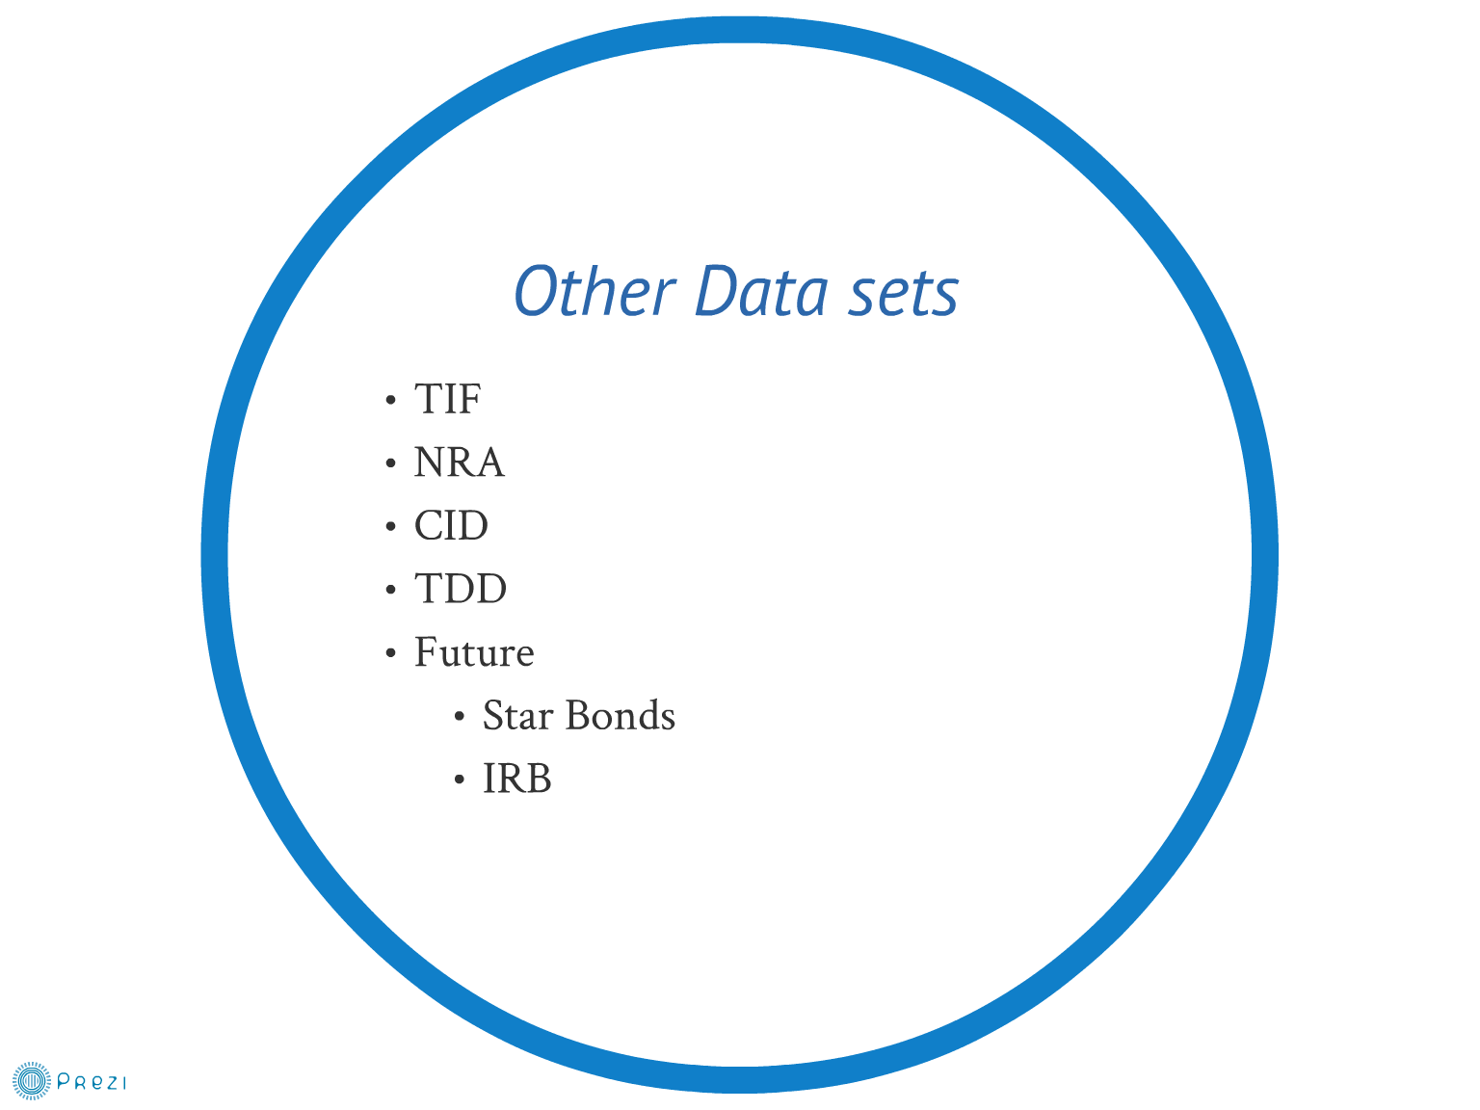

Slide 23
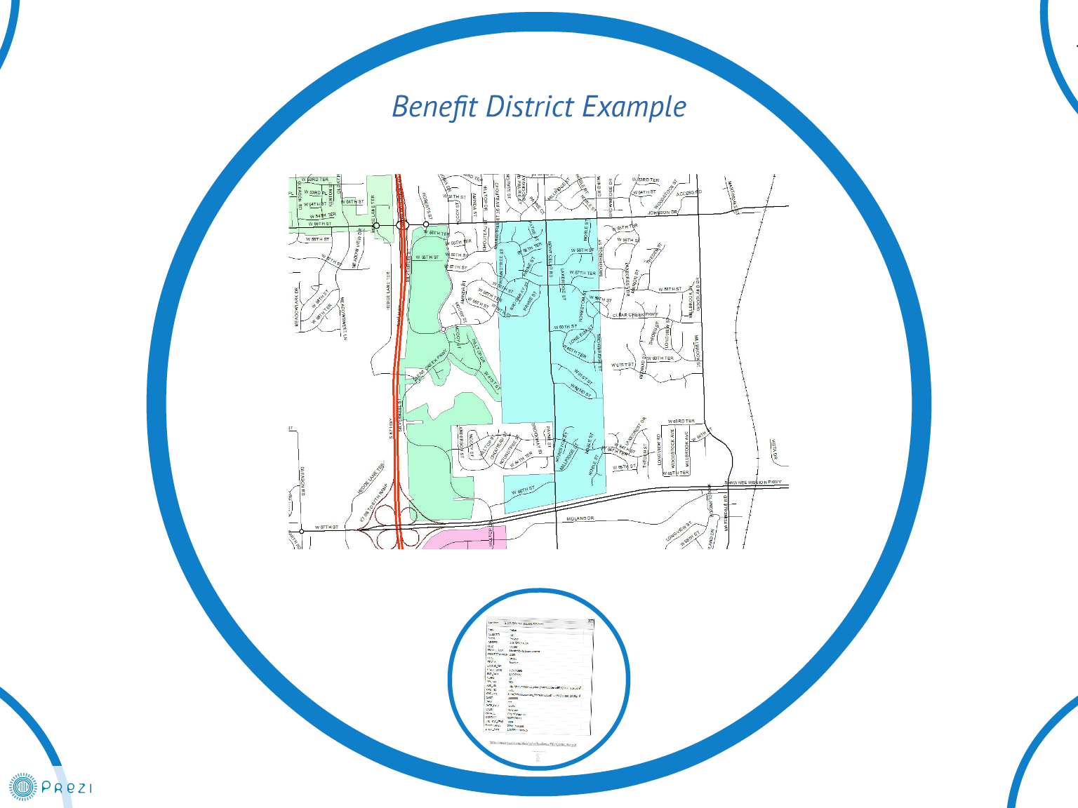

Slide 24
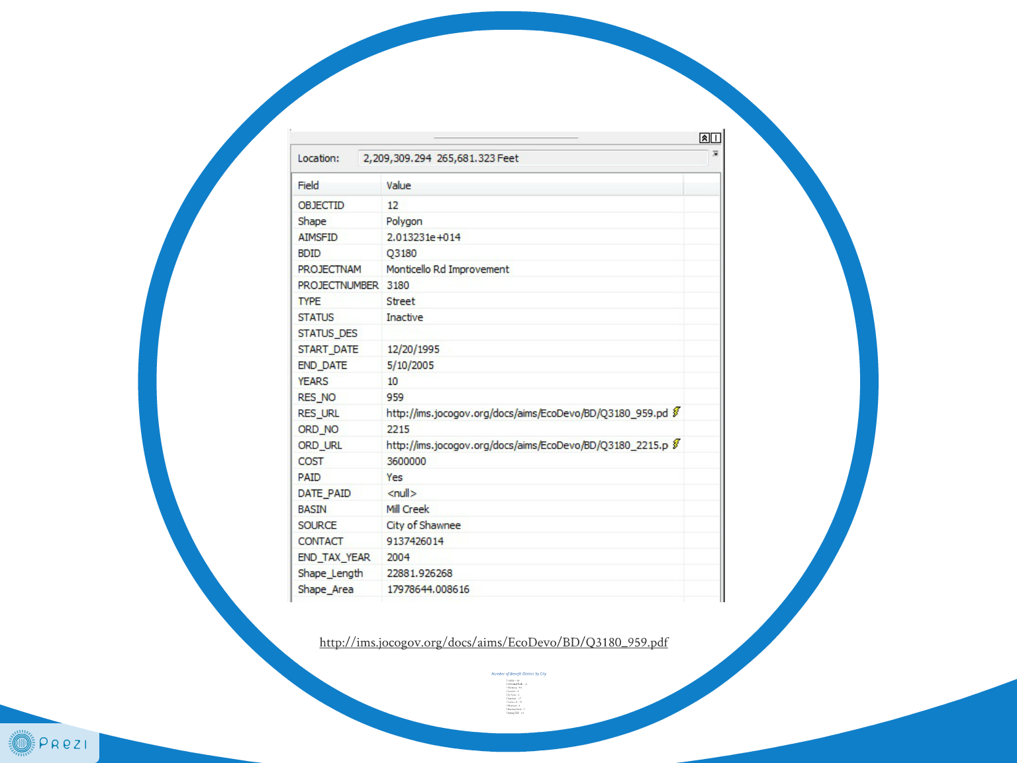

Slide 25
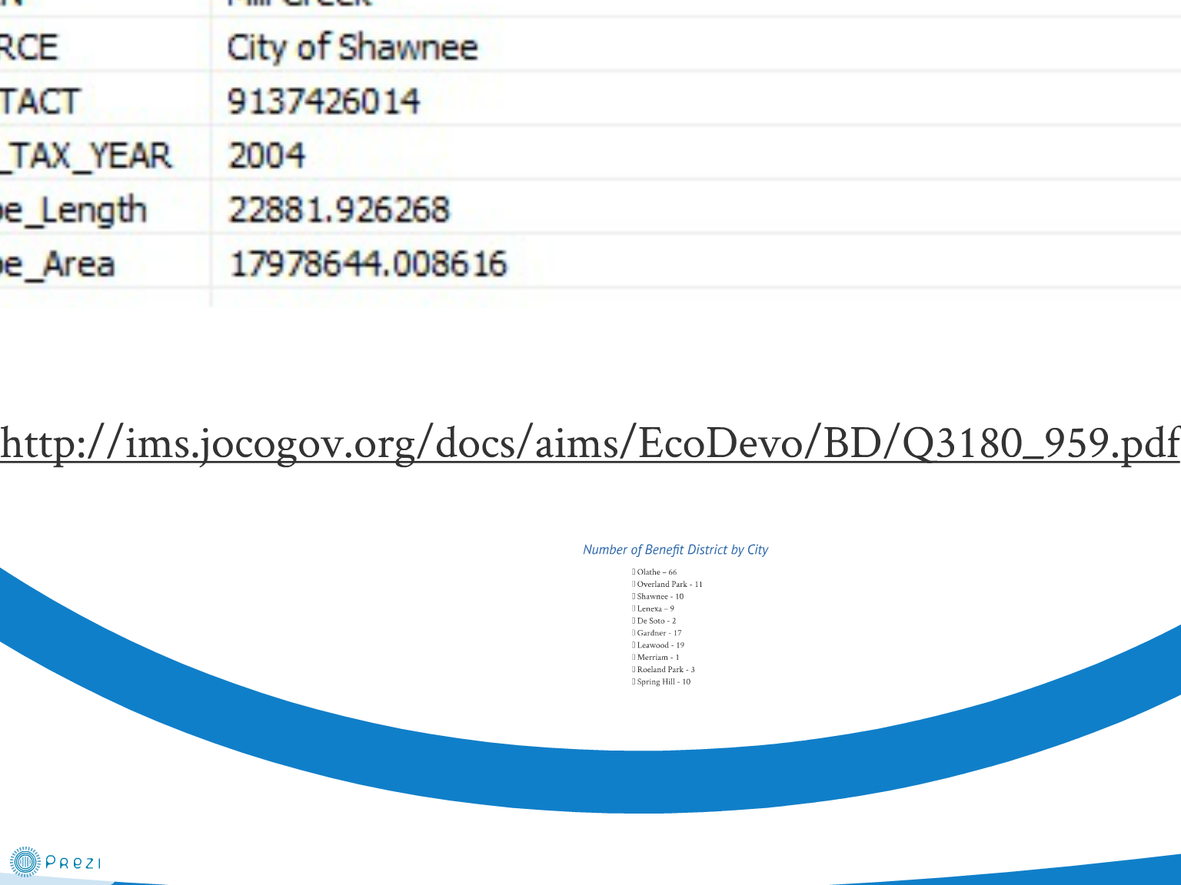

Slide 28
Find yourself
with Geolocation

Slide 29
W3C Geolocation API
Specification for obtaining device location in a web browser - not really HTML5
Why important?...
In a browser
Microsoft Internet Explorer 9.0 and up
Mozilla Firefox 3.5 and up
Apple Safari 5.0 and up
Google Chrome 5.0 and up
Opera 10.6 and up
iPhone 3.0 and up
Android 2.0 and up
Incredibly simple

Slide 30
How Geolocation works
Four ways to get a location
IP Geolocation – city accuracy
Wi-Fi Positioning – wireless radio
Cell Tower Triangulation
GPS
Each technology adds a level of certainty to W3C geolocation.

Slide 31
How Geolocation works
3 Methods
getCurrentPosition()
Parameters
successCallback
errorCallback
options
EnableHighAccuracy
Timeout
maximumAge
Return – Position object
Latitude
Longitude
Altitude
Accuracy
altitudeAccuracy
Heading
speed
watchPosition()
clearWatch()

Slide 35
How Geolocation really works
navigator.geolocation.getCurrentPosition(successCallback);
function successCallback (position) {
var lat = position.coords.latitude;
var lng = position.coords.longitude;
setmapextent(lat, lng);
}

Slide 36
How Geolocation works
3 Methods
getCurrentPosition()
Parameters
successCallback
errorCallback
options
EnableHighAccuracy
Timeout
maximumAge
Return – Position object
Latitude
Longitude
Altitude
Accuracy
altitudeAccuracy
Heading
speed
watchPosition()
clearWatch()

Slide 38
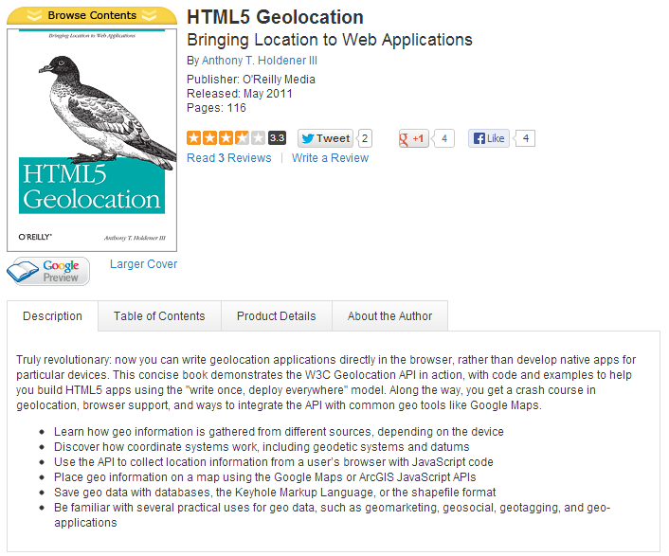

Slide 39
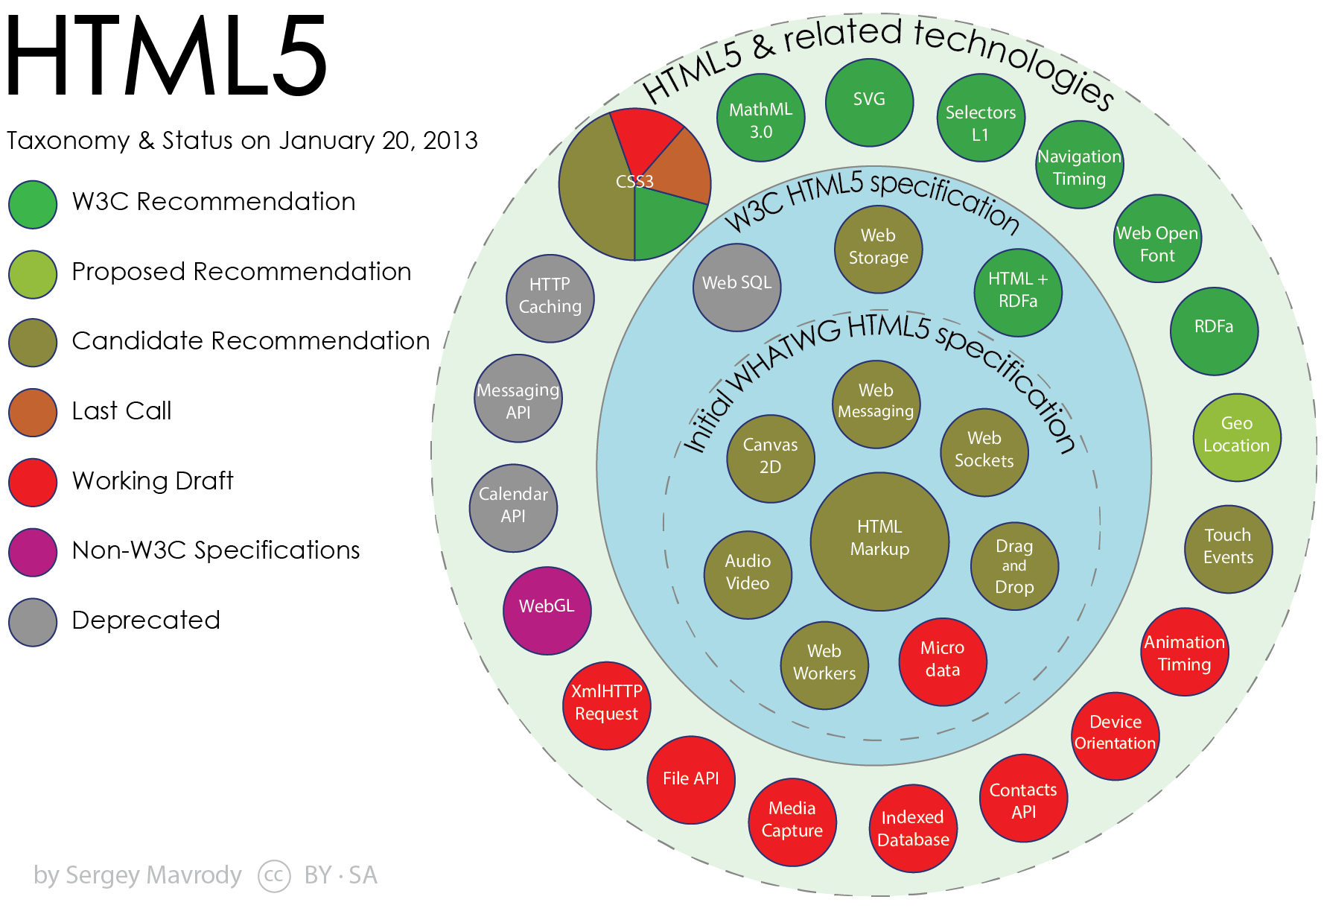

Slide 40
Questions?
Dan.Steen@jocogov.org

