Slide 1
KCAIUG January 2015

Slide 2
Mapping in Johnson County
AIMS was initiated by the Board of County Commissioners in the mid-1980s. The major reason for establishing AIMS was to enable the county to meet the rigorous mapping and documentation requirements of the complete property reappraisal mandated by the Kansas State Legislature.
AIMS has since grown into a highly integrated support and service department within the county. We offer many services including map production, custom enterprise-level application development, and data development.
Notes:
Insert a picture of one of the geographic features of your country.

Slide 3
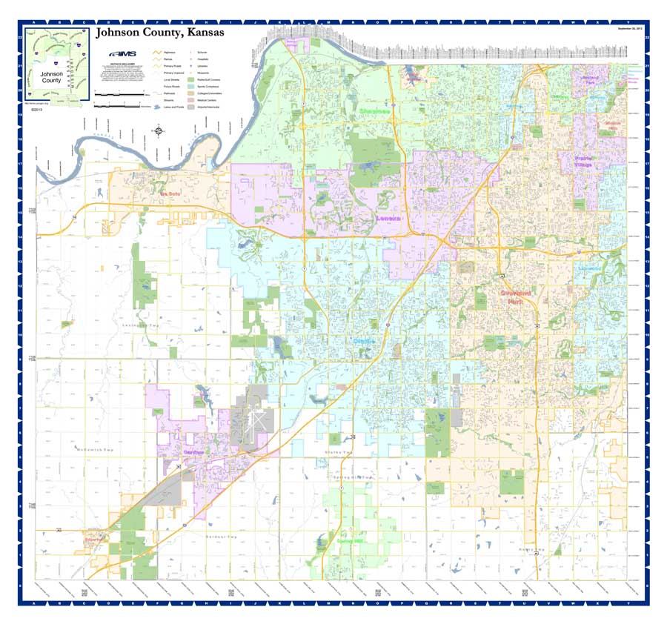
EXAMPLES of AIMS maps
Johnson County Road Map
Notes:
Insert a picture of one of the geographic features of your country.

Slide 4
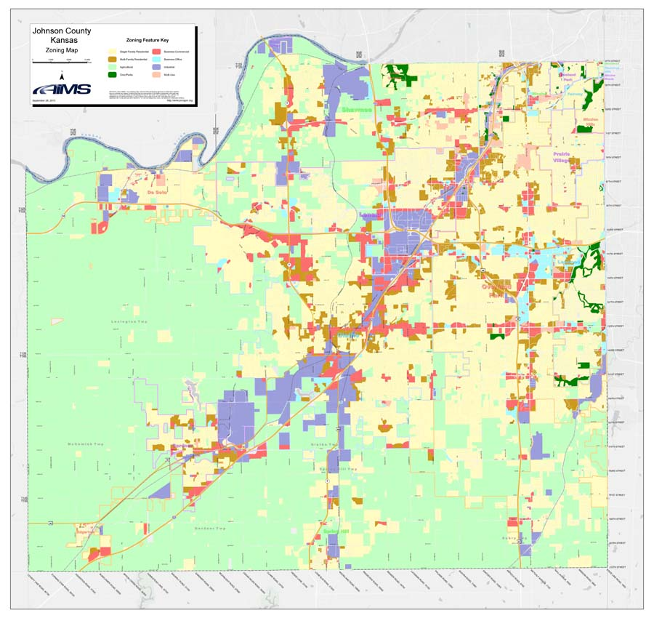
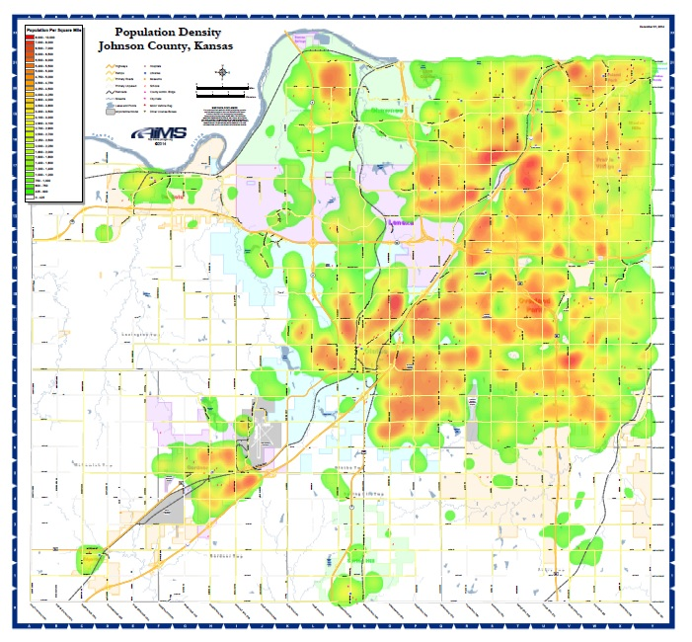
EXAMPLES of AIMS maps
Johnson County Zoning Map
Johnson County Population Density Heat map
Notes:
Insert a picture of one of the geographic features of your country.

Slide 5
EXAMPLES of AIMS maps
Johnson County Policy Area Map
Johnson County Teen Birth Rate Map
For Planning Department
For Public Health and Human Services
Notes:
Insert a picture of one of the geographic features of your country.

Slide 6
EXAMPLES of AIMS maps
Johnson County Major Employers
For County Manager
Notes:
Insert a picture of one of the geographic features of your country.

Slide 7
EXAMPLES of AIMS maps
Johnson County Employee Commute times
For County Manager
Notes:
Insert a picture of one of the geographic features of your country.

Slide 8
EXAMPLES of AIMS maps
Residential Appraised Value Changes
For County Manager reports
Notes:
Insert a picture of one of the geographic features of your country.

Slide 9
EXAMPLES of AIMS maps
Examples of AIMS animated maps
Johnson County Plat growth 1865 - 2014
Notes:
Insert a picture of one of the geographic features of your country.

Slide 10
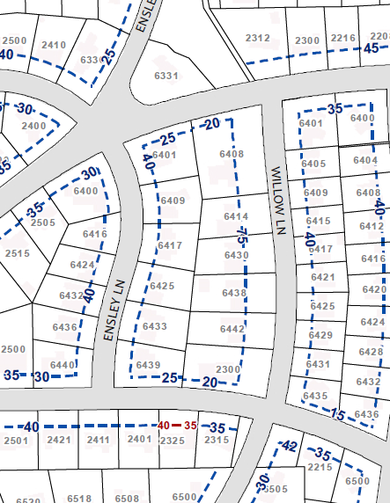
EXAMPLES of AIMS maps
City of Mission Hills Building Setbacks
City of Fairway
Notes:
Insert a picture of one of the geographic features of your country.

Slide 11
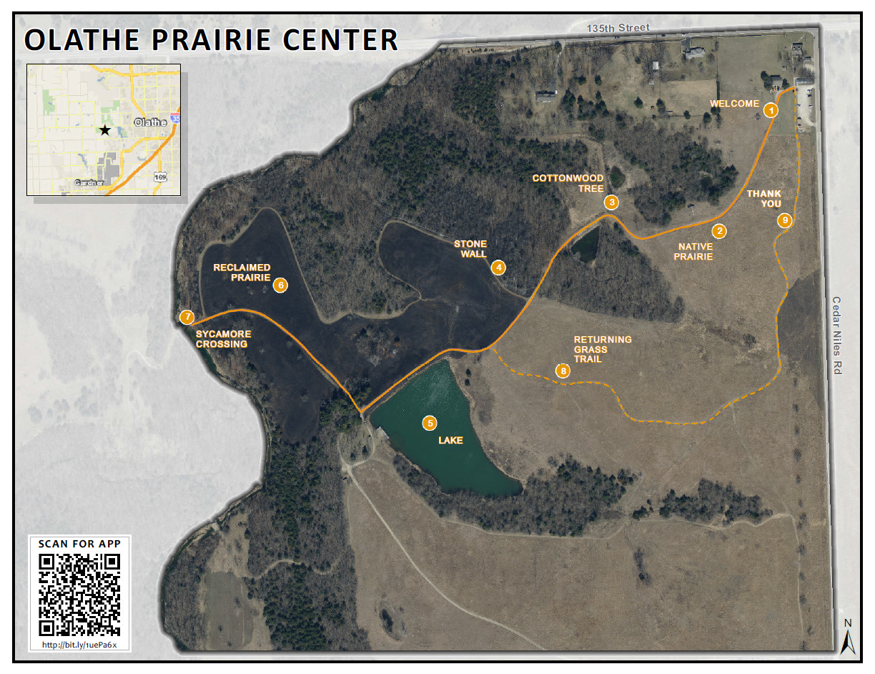
EXAMPLES of AIMS maps
Olathe Prairie Center Path map & QR Code
For Kansas Department of Wildlife and Parks - http://bit.ly/1uePa6x
Notes:
Insert a picture of one of the geographic features of your country.

Slide 12
EXAMPLES of AIMS maps
Church Parishioner locations
For local church in Leawood
Notes:
Insert a picture of one of the geographic features of your country.

Slide 13
EXAMPLES of AIMS maps
University & Public Health Dept locations
For private citizen working on dissertation
Notes:
Insert a picture of one of the geographic features of your country.

Slide 15
ESRI Lessons Learned 2014
Imagery
SDE Raster at 10.2
Desktop 10.2
ArcGISPro
Desktop 10.3?
Listserve comment

Slide 16
ESRI Lessons Learned 2014

Slide 17
ESRI Lessons Learned 2014
Mosaic - Possible Benefits:
Faster to get in useable format
Faster responsiveness?
File storage may be cheaper than database storage
Less duplication
Requires Image server extension to serve via ArcGIS server

Slide 18
ESRI Lessons Learned 2014
Bugs
FC creation - "Underlying DBMS error ... Invalid precision value“
10.2 Bug - Field Length
Supposed to be fixed at 10.2.2 and 10.3
Change the length of the text field to <4000

Slide 19
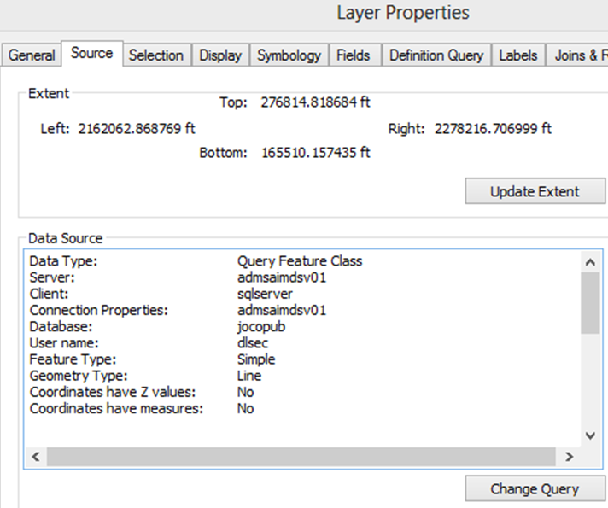
ESRI Lessons Learned 2014
Change SDEviews to SQLviews
Layer files - SDE Feature Class vs Query Feature Class
Slow (10x)-
source
Scripting update with “ReplaceDataSource” does not work
Table won’t open
Selections not drawn
Cannot zoom to selection

Slide 20
ESRI Lessons Learned 2014
Upgrades
Custom configurations in SDE_DBTune do not necessarily get ported during an SDE “upgrade”.

Slide 21
ESRI Lessons Learned 2014
ESRI recommends changing from 3 tier to 2 tier connection type.
Script to update the connection
Does not work for raster
Stops and waits on input on certificate errors

Slide 22
ESRI Lessons Learned 2014
Changing data to SQL spatial is easy… unless you have to:
Upgrade precision
Set spatial references
Look for fields that might be problematic
Finally MigrateStorage!

Slide 23
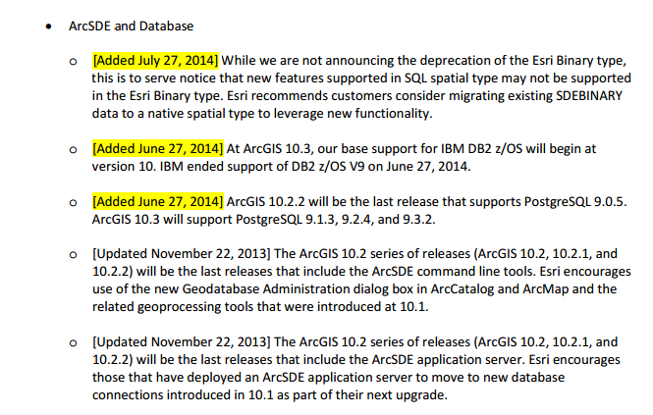
ESRI Lessons Learned 2014
From the 10.2 deprecation doc

Slide 24
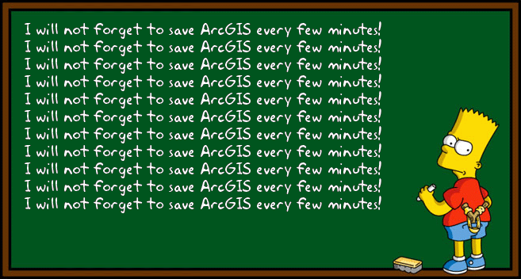

Slide 25
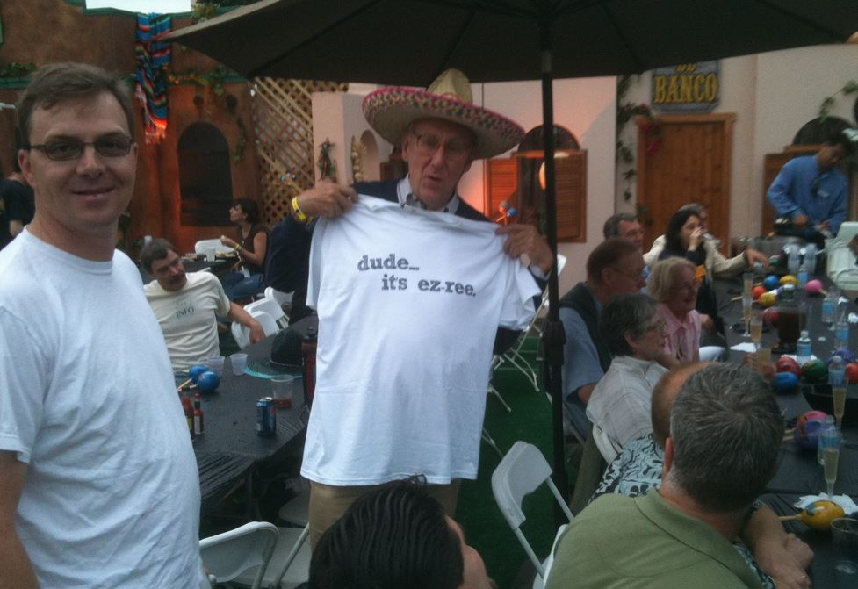
Q&A

Slide 27
What have we done recently
at the database level
that are …
► Extending our capabilities
► New and innovative
► Making us more productive
► Making us more efficient
► Making our data more …
Open / Accessible / Consumable

Slide 28
Database Environment

Slide 29
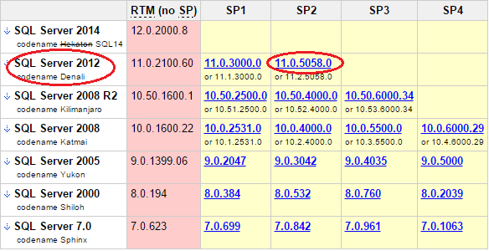
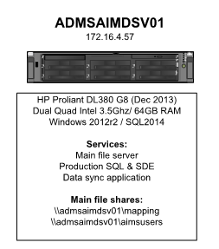
SQL 2012

Slide 30
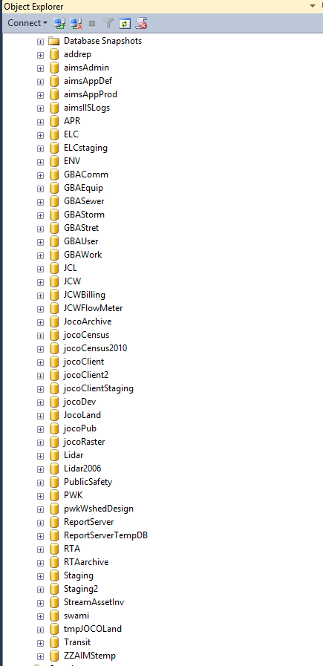
Databases on the AIMS Data Server (admsaimdsv01)

Slide 31
•Editing Feature Classes (development)
•
•
•
•
Databases on the AIMS Data Server (admsaimdsv01)
•
•

Slide 32
•Editing Feature Classes (development)
•
•Published Feature Classes (current)
•
•
•
jocoPub
•
Databases on the AIMS Data Server (admsaimdsv01)
•
•

Slide 33
•Editing Feature Classes (development)
•
•Published Feature Classes (current)
•Archived Feature Classes (mrp and ss)
•
•
•
•
jocoPub
•
Databases on the AIMS Data Server (admsaimdsv01)
•
•
•

Slide 34
•Editing Feature Classes (development)
•
•Published Feature Classes (current)
•Archived Feature Classes (mrp and ss)
•Imagery
•
•LIDAR
•
•
•
jocoPub
•
•
•
•
Databases on the AIMS Data Server (admsaimdsv01)
•
•
•

Slide 35
•Editing Feature Classes (development)
•
•Published Feature Classes (current)
•
•Archived Feature Classes (mrp and ss)
•Imagery
•
•
•LIDAR
•
•
•Non-Feature Class “Attribute Data”
•
•
•
•
jocoPub
•
•
•
•
•
Databases on the AIMS Data Server (admsaimdsv01)
•
•
•

Slide 36
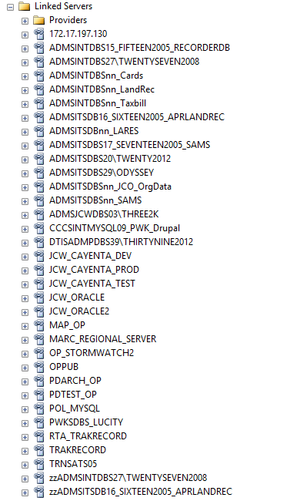

Slide 37
Geometry Data Type
(SQL Server’s native spatial data type)
0:45

Slide 38
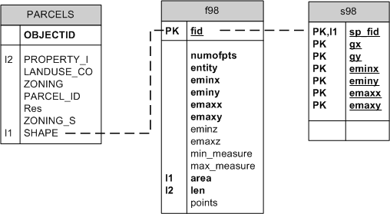
•SDE Binary
•Editing Feature Classes

Slide 39
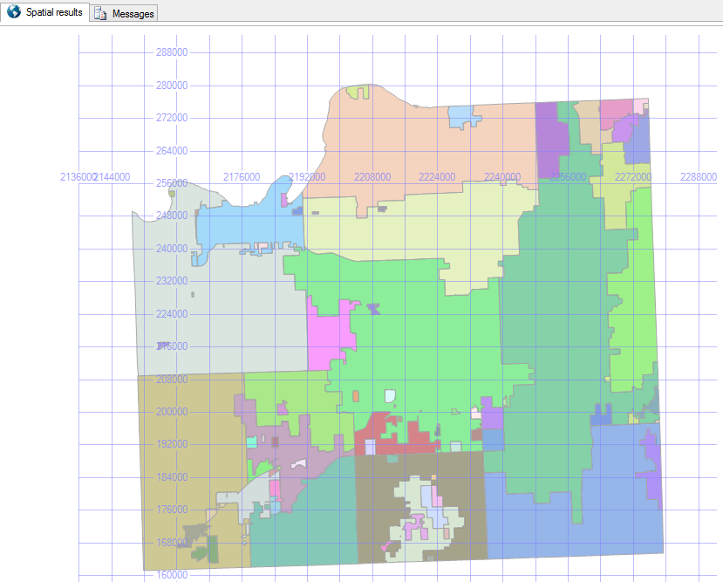
•SQL Server’s native spatial data type (geometry)
•Published Feature Classes (current)
•Archived Feature Classes (mrp and ss)

Slide 41
SQL Server Spatial Methods
(Database Geoprocessing)
1:20

Slide 42
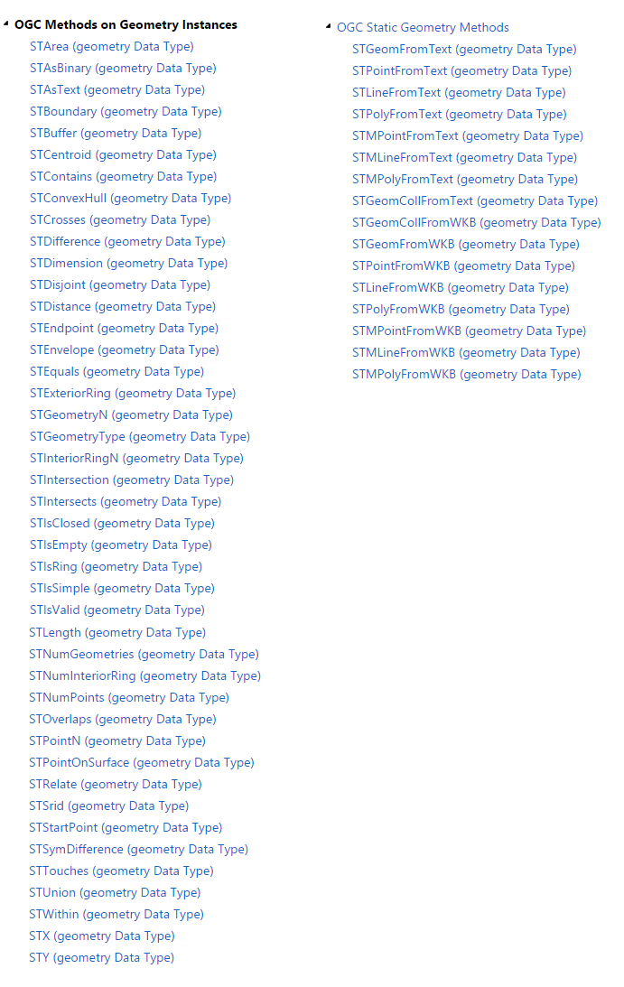
STArea
STBuffer
STCentroid
STContains
STDistance
STIntersects
SQL Server
Spatial Methods
STLength
STOverlaps
STWithin

Slide 43
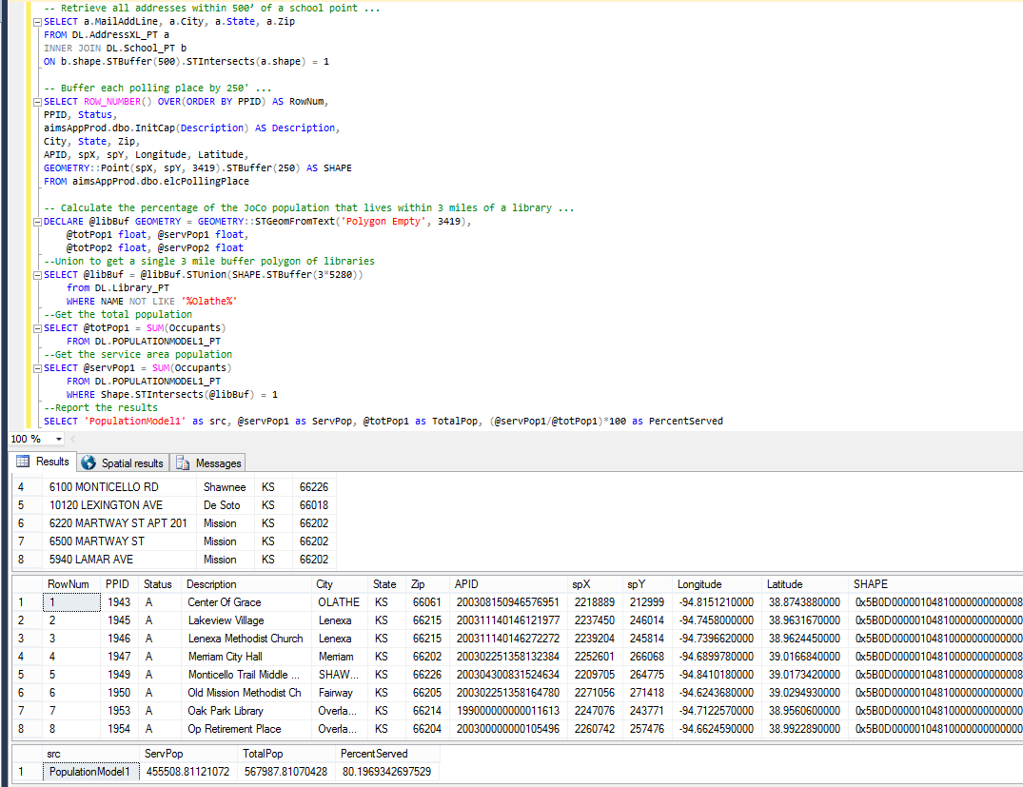
Retrieve all addresses within 500’ of a school
Buffer each polling place by 250’
Calculate the % of population that lives
Within 3 miles of a library
Retrieve all addresses within 500’ of a school
Buffer each polling place by 250’
Calculate the % of population that lives
Within 3 miles of a library

Slide 44
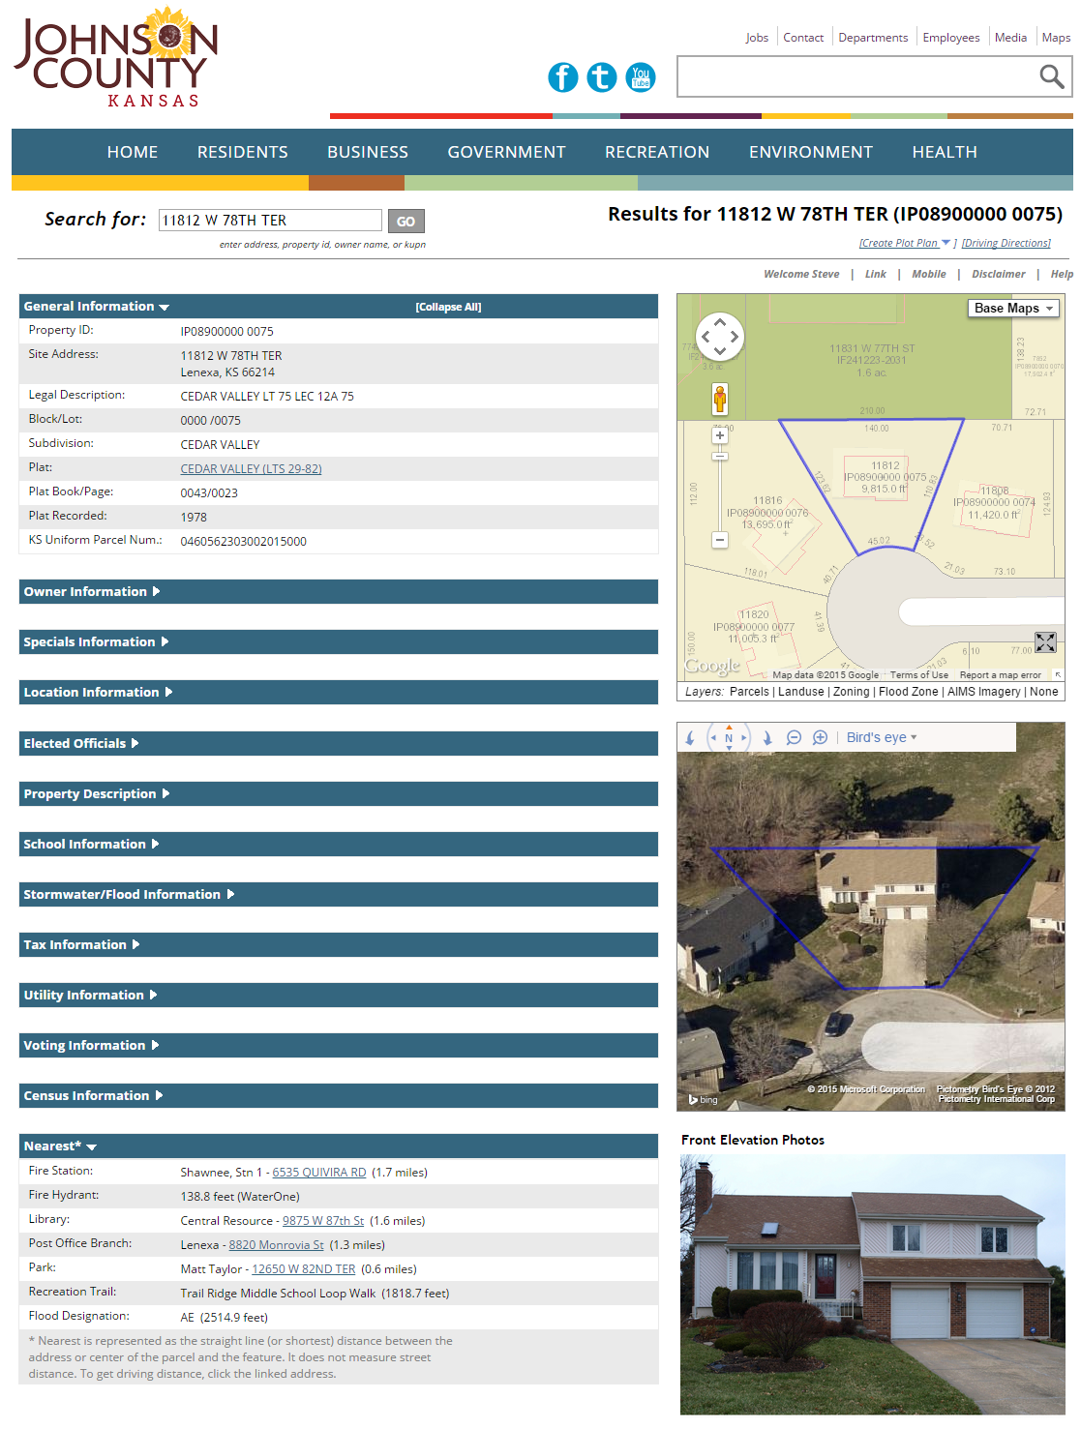
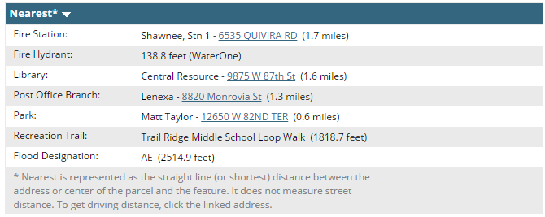

Slide 45
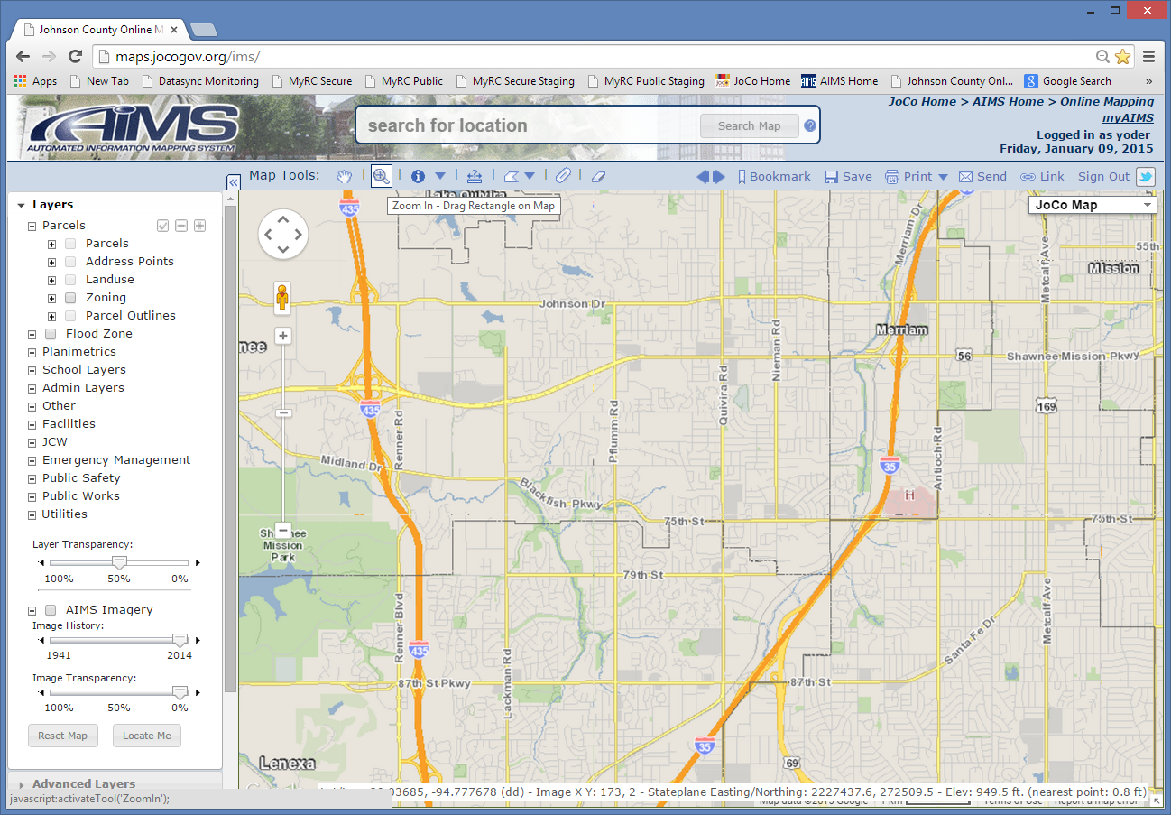

Slide 46
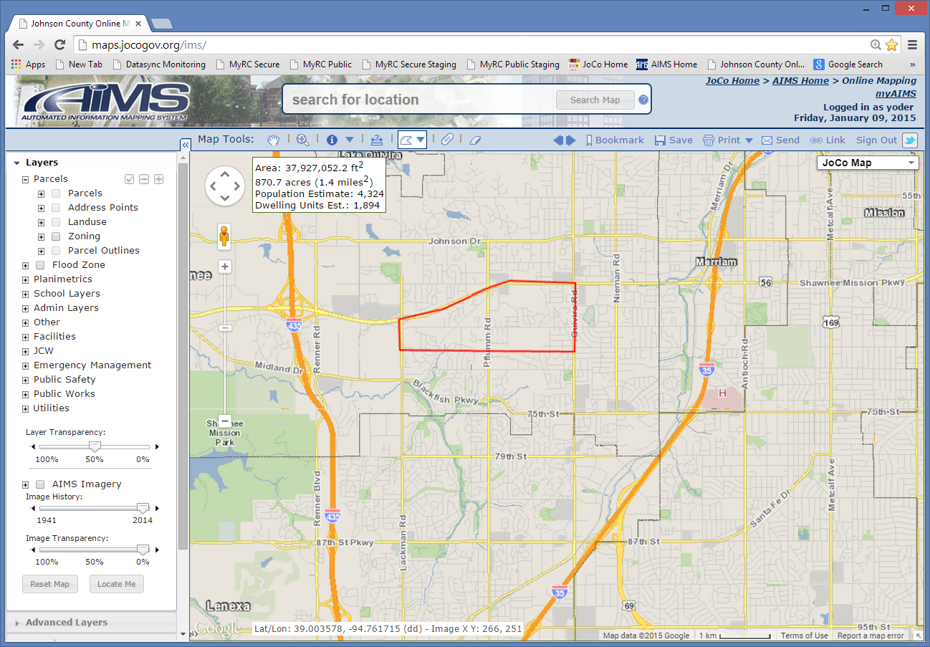

Slide 47
Database Projections
2:15

Slide 48
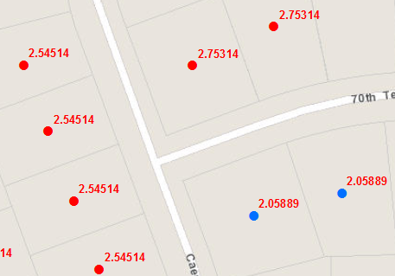
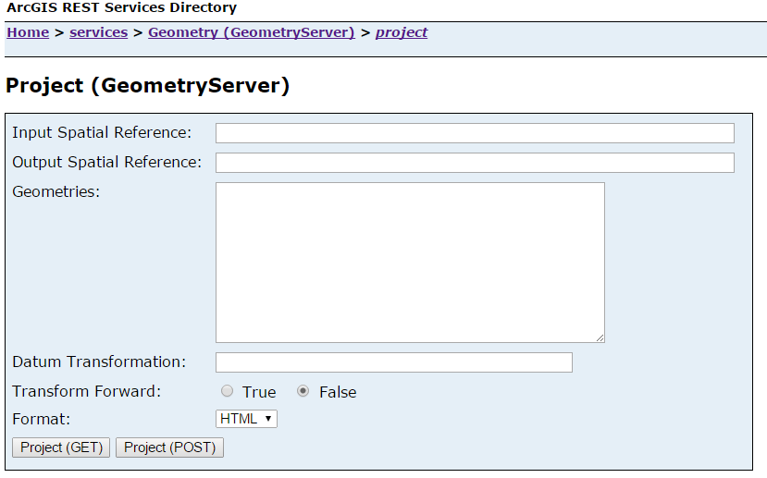
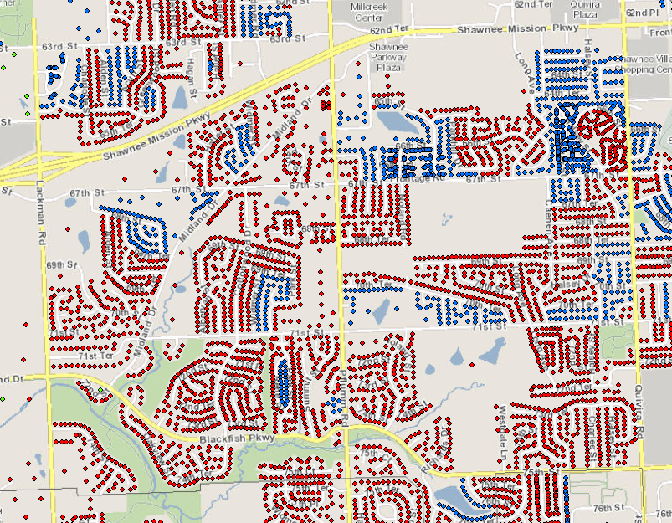
39.008949,-94.761589
39.009616,-94.756096
39.014951,-94.73893
39.014649,-94.723434
39.003378,-94.723434
39.003578,-94.7612
SELECT SUM(occupants) AS PopEstimate
PopulationModel1_PT
fnProjectPoly
(CLR function)
KS North State Plane
Coordinates (as WKT)
STGeomFromText
STContains

Slide 49
Database Geocoding
2:35

Slide 50
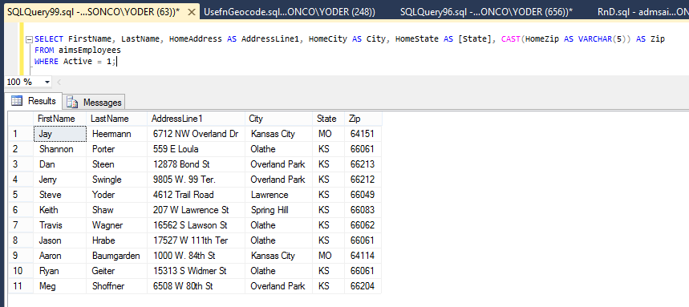
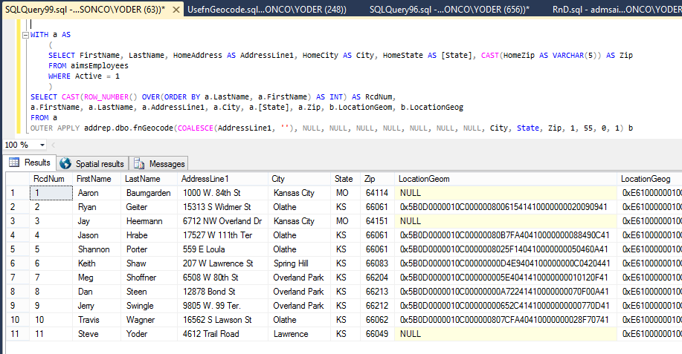
MinScore
GeocodeOption

Slide 51
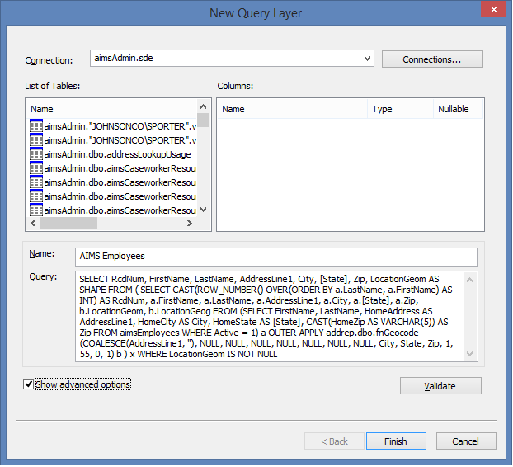
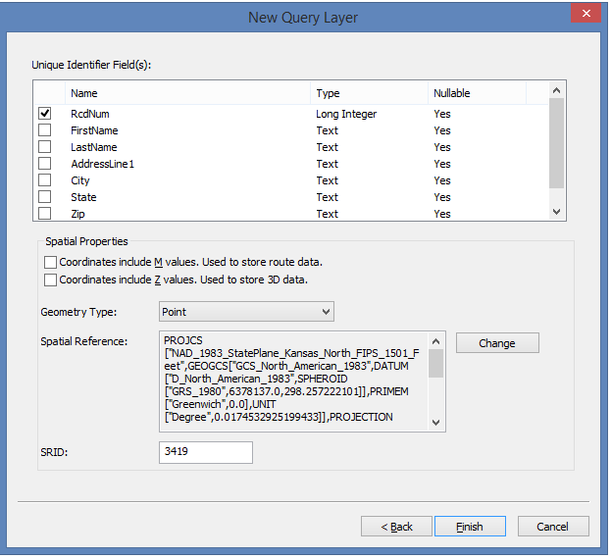
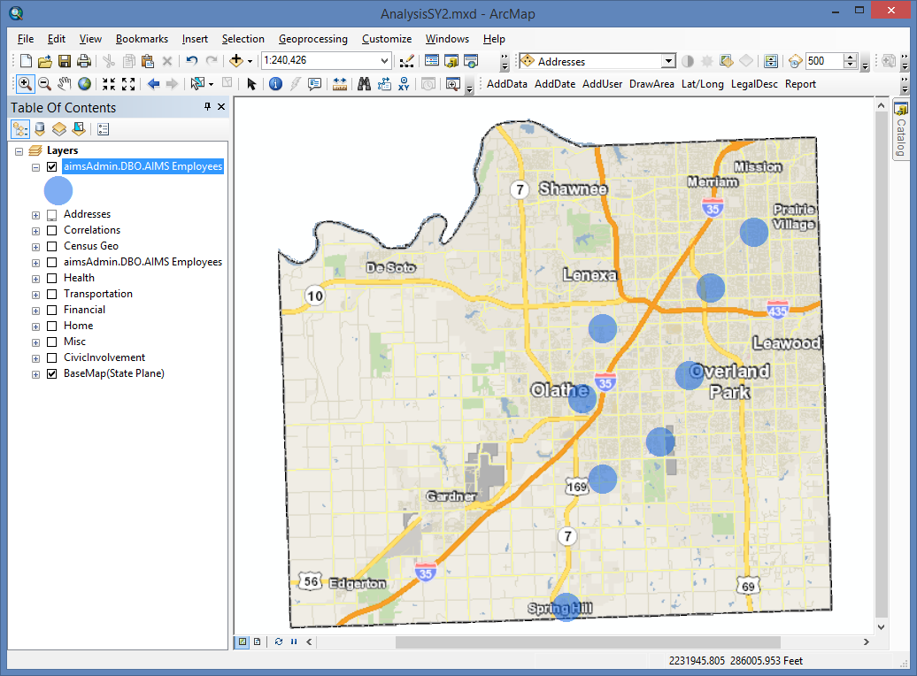

Slide 52
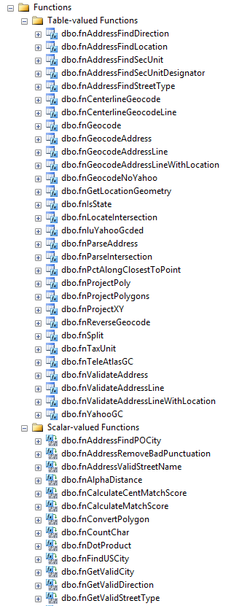
fnCenterlineGeocode
fnGeocode (Parent)
fnTeleAtlasGC (CLR function)
fnValidateAddress (Address Points)
fnYahooGC (CLR function)

Slide 53
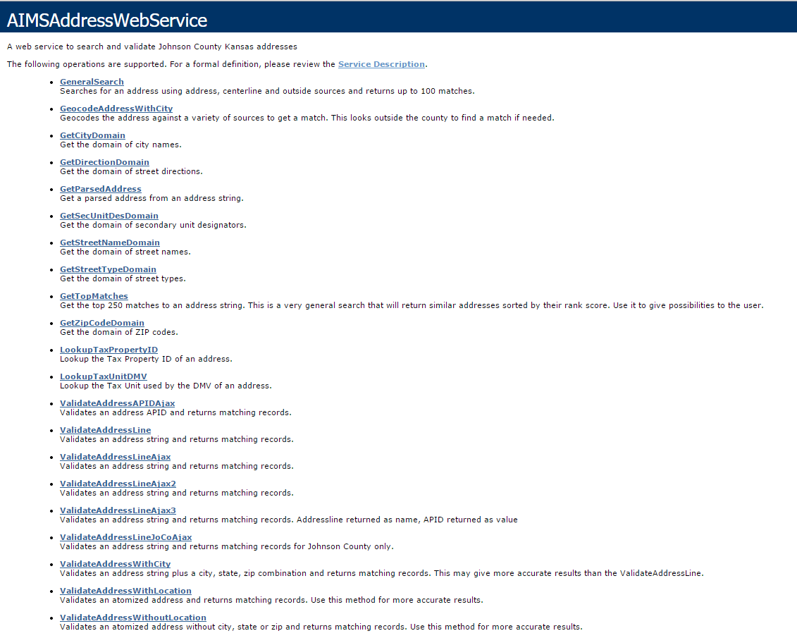

Slide 54
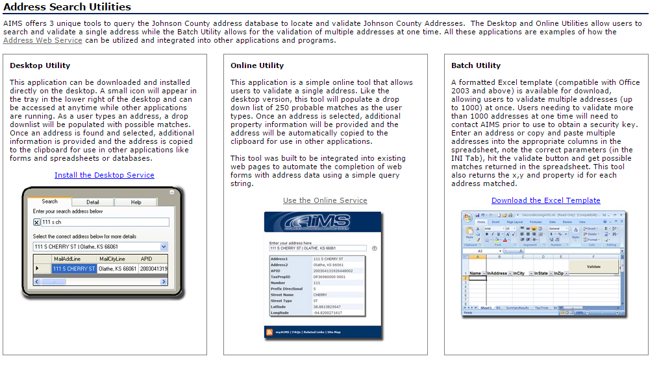

Slide 55
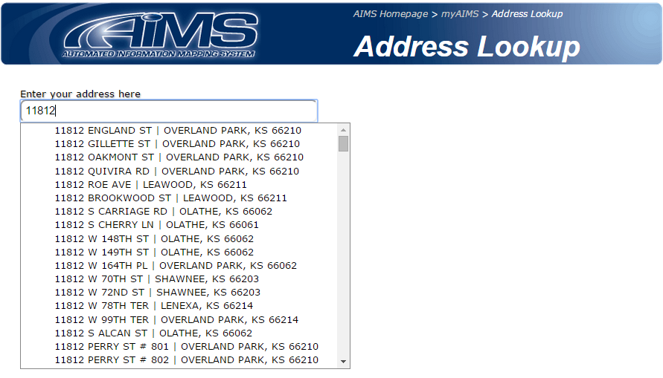
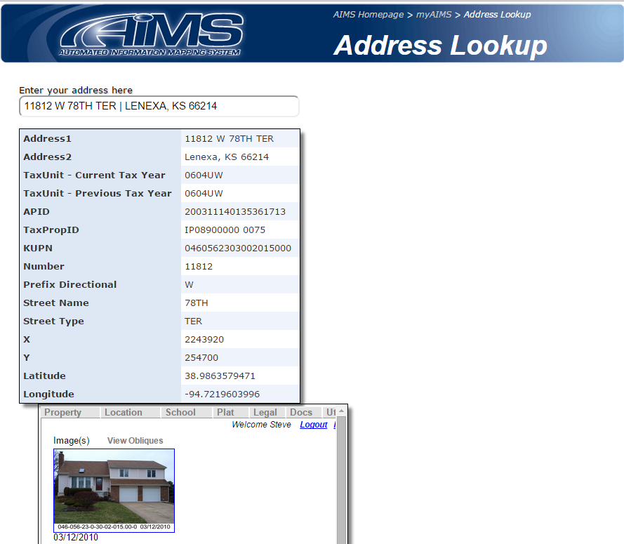

Slide 56
Truncate/Replace
Data Publishing
3:05

Slide 57
Editing FCs in
Development Databases
Published FCs in
jocoPub Database

Slide 58
Editing FCs in
Development Databases
Published FCs in
jocoPub Database
ArcObjects
FC
FC

Slide 59
Editing FCs in
Development Databases
Published FCs in
jocoPub Database
ArcObjects
X
FC
FC
FC

Slide 60
Editing FCs in
Development Databases
Published FCs in
jocoPub Database
ArcObjects
FC
FC

Slide 61
Editing FCs in
Development Databases
Published FCs in
jocoPub Database
FME Workspace
Truncate/Insert
X
FC
FC
Locks are immaterial

Slide 62
Published FCs in
jocoPub Database
Archived FCs in
jocoArchive Database
SQL Server
Stored Procedure
Truncate/Insert
FC
MRP FC
Huge time savings

Slide 63
►Reading input parameters to a
.py .fmw .exe .sql
from a DB table
►Writing log data to a DB table
3:45

Slide 64
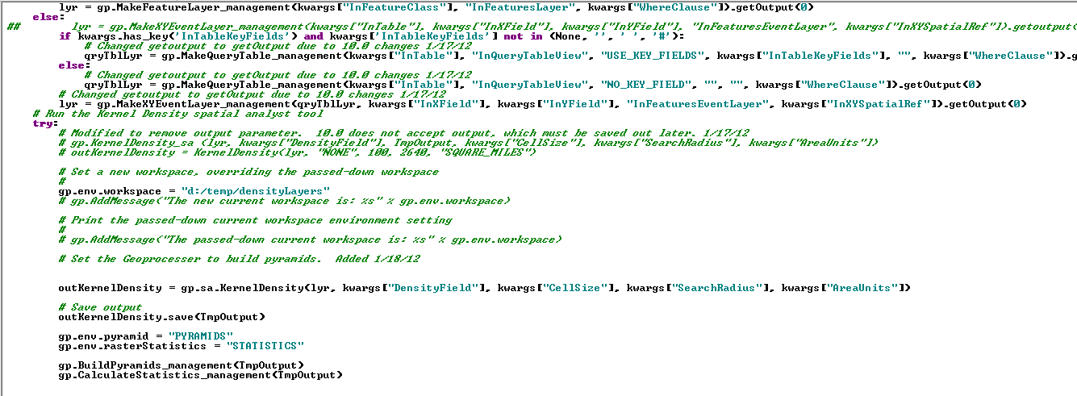

Slide 65
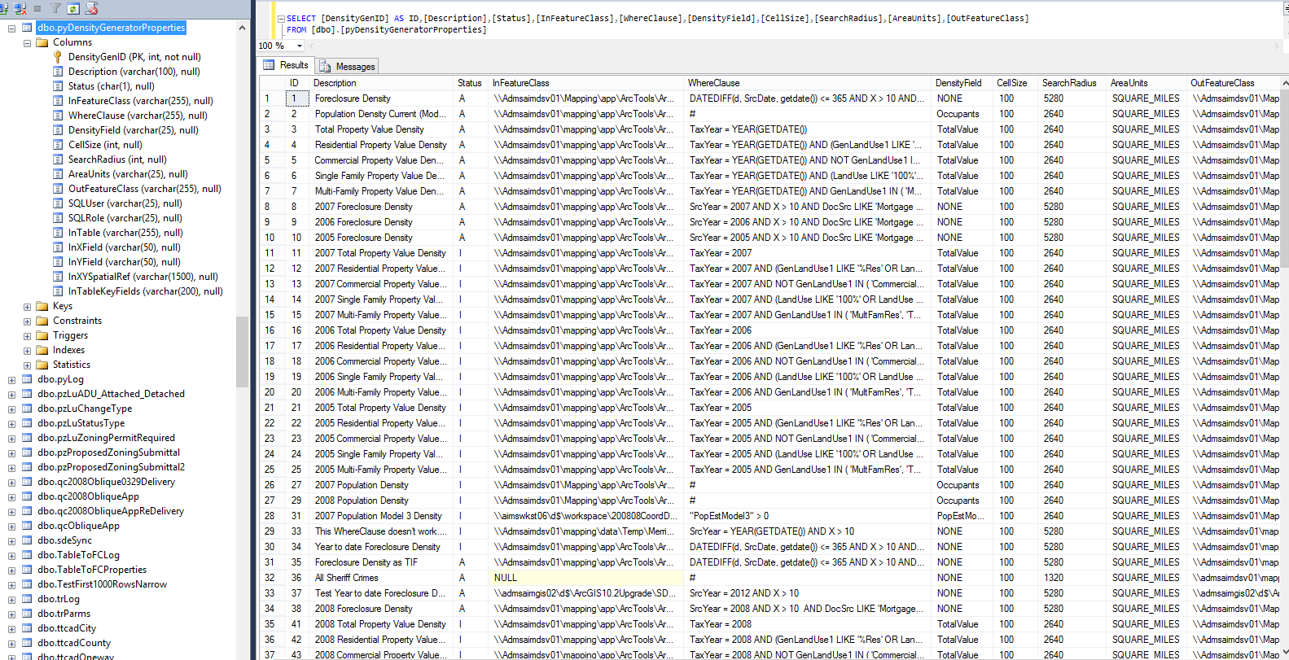
►Reading input parameters

Slide 66
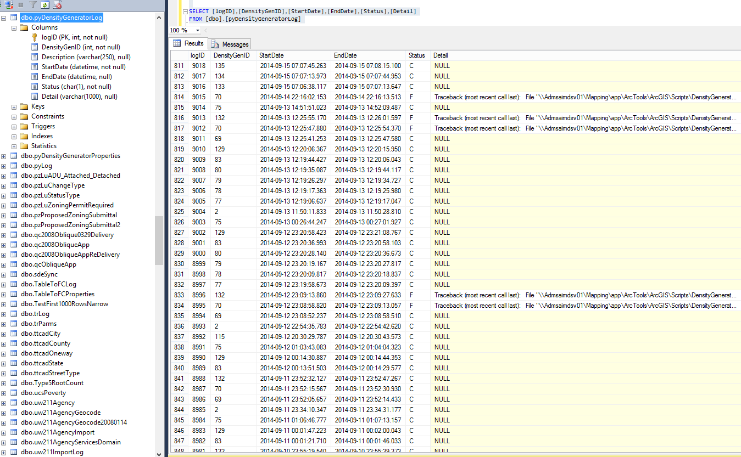
►Writing log data
ID of input parameters record
Start DT
End DT
Status
Detail (error message)

Slide 67
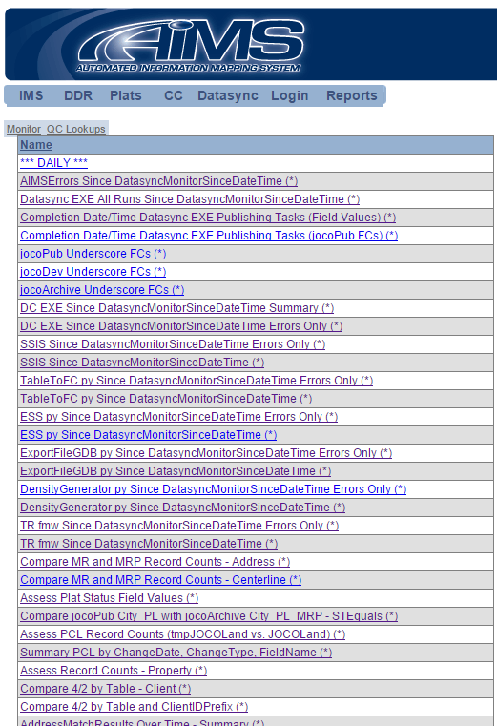
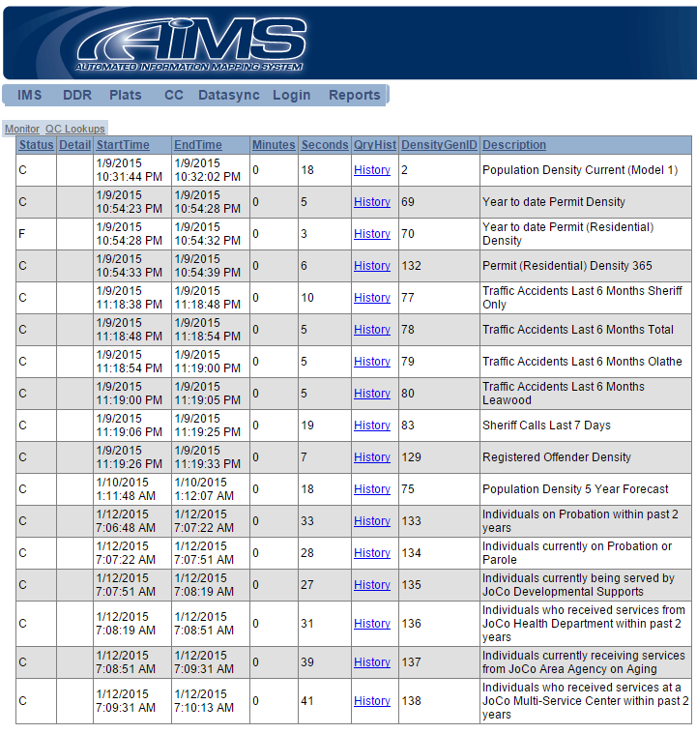

Slide 68
Check the validity of URLs
in a table
4:15

Slide 69
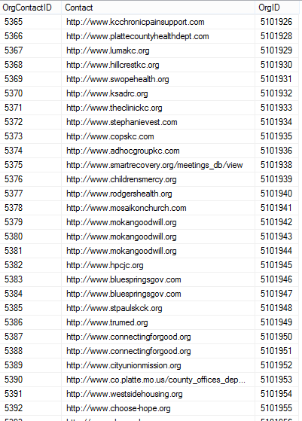
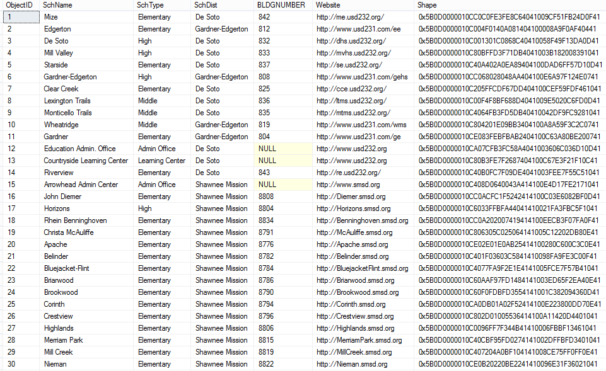
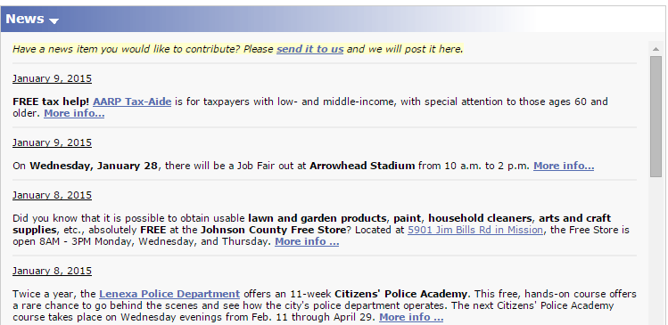

Slide 70
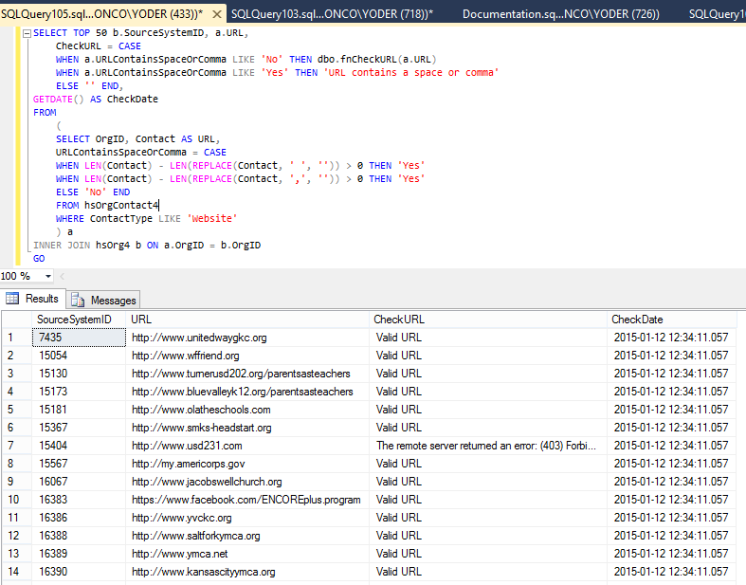
fnCheckURL
Links kept current

Slide 71
Performance & Configuration
4:35

Slide 72
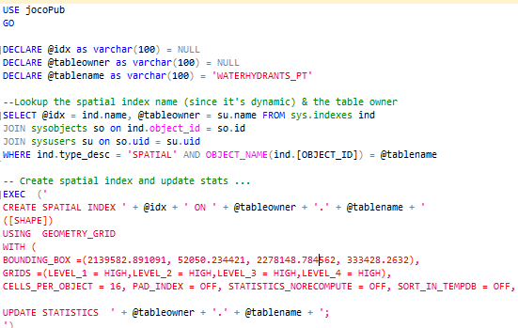

Slide 73
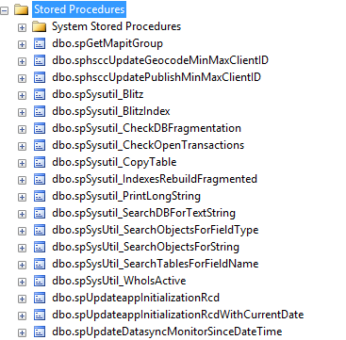

Slide 74
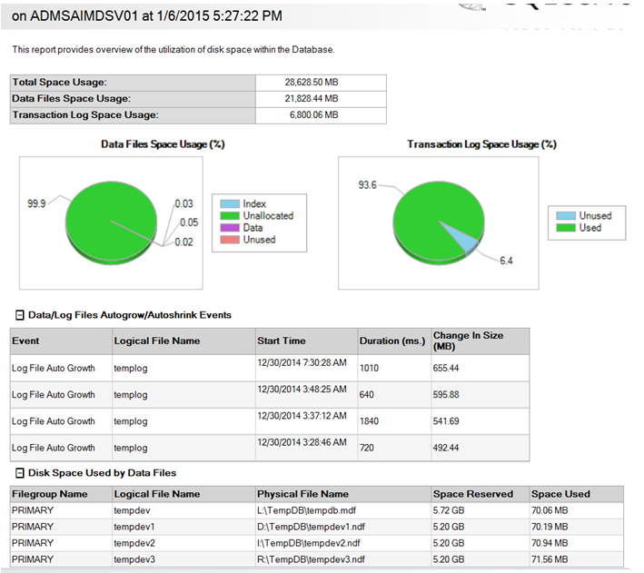

Slide 75
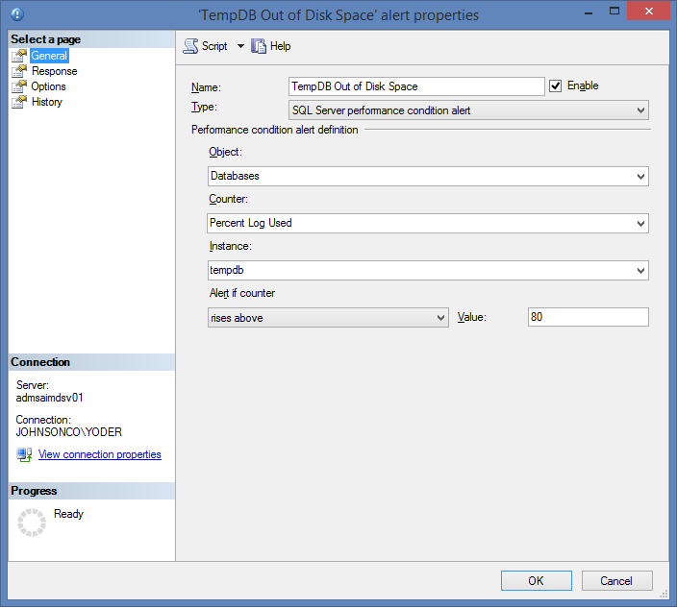
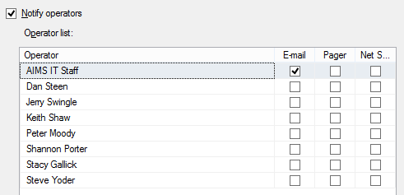
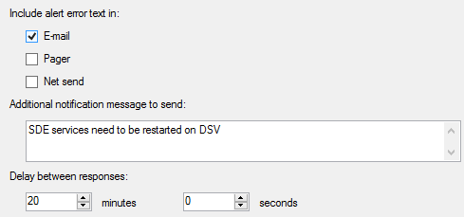
Using SDE services
(to support application [i.e., 3 tier] connections)
on SQL Server 2012 on Windows 2012 Server …
a hung process can block transactions in tempdb
thereby not allow it to truncate itself

Slide 76
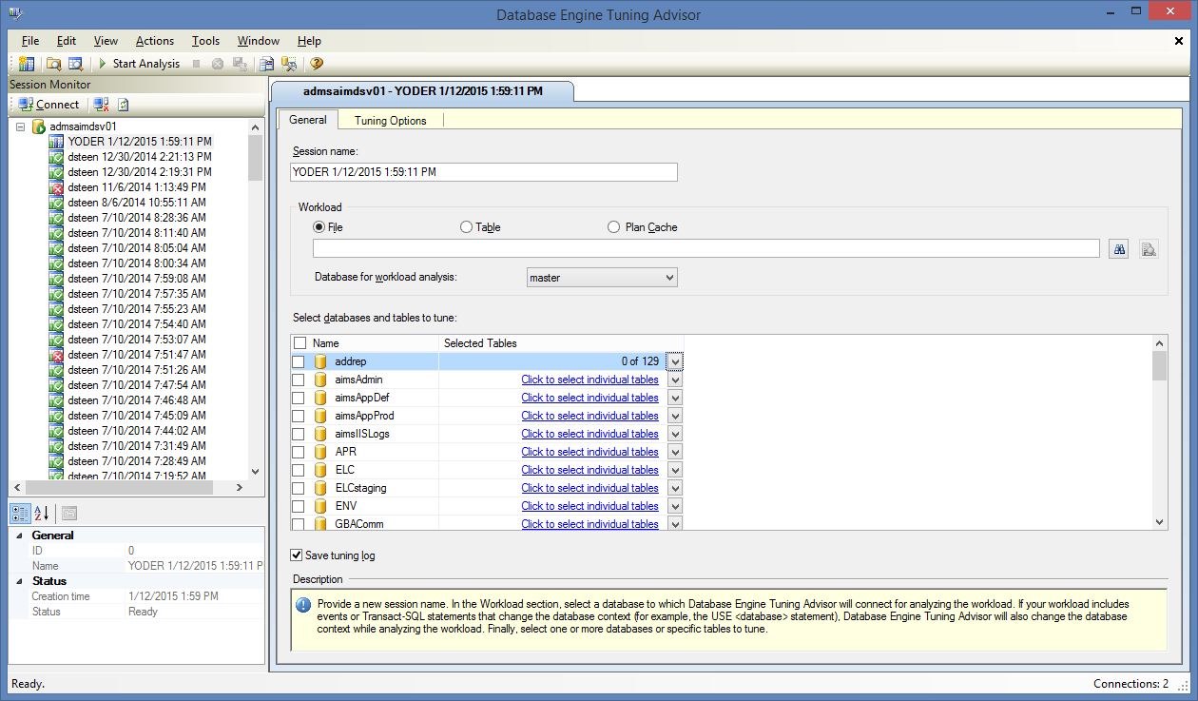
Database Engine Tuning Advisor

Slide 78
Location Services

Slide 79
Request to digitize setback information from plats to printed map.

Slide 83
Alternative to digitizing plats for entire county?
Simple, open access for property owners to access their lot dimensions, setbacks, easement/right-of-way designations from plat.
Add plat “chips” to our existing Location Services pages (using existing map service)

Slide 87
All our plat images were georeferenced (or so we thought!).

Slide 93
http://ims.jocogov.org/locationservices/?id=NP10230000 0001

Slide 95
How does that work?
From Parcel ID go get plat attributes (e.g. id, name, etc) and parcel extent

Slide 97
How does that work?
From Parcel ID go get plat attributes (e.g. id, name, etc) and parcel extent
From parcel extent, get map tile (can do this through the use of dynamic layers in the map service)

Slide 101
Uh oh…

Slide 104
Need for QC & Cleanup
Ran some file system scripts
Built quick QC interface
http://ims.jocogov.org/locationservices/mapPlatQC.aspx
Log results to table
8,919 Plats
75% passed QC
2,000 plat images to review – 30% complete

Slide 109
Query Layer Updates
Use data that doesn’t contain system geodatabase repository tables
Provides ability to join related business tables & disparate sources on the fly to spatial data sources without the overhead of creating additional datasets
Benefit is displaying realtime updates to attribute tables without publishing datasets
Use sql views to keep database logic on the database
much easier to manage & edit views than mxd
Can edit via feature access enabled map service

Slide 112
Using SQL Views & Query Layers to make decisions - JCW Sewer Rehab

Slide 113
Line Inspection Model (FME)

Slide 114
Review Process

Slide 115
Needs
Map based review
Place to make revisions –web editing?
Way to feed revisions back to Lucity

Slide 116
Decision

Slide 117
What did SQL VW's/query layers allow us to do?

Slide 118
And how does JCW benefit?

Slide 119
The Ultimate benefit
***Better Decision Making***

Slide 120
Create Views
Don’t put this in your .mxd

Slide 123
JCW & Special Assessments

Slide 124
JCW & Special Assessments

Slide 125
JCW & Special Assessments

Slide 129
Plat QC
Real-time display of business table updates.

Slide 130
Plat QC
http://ims.jocogov.org/locationservices/mapPlatQC.aspx

Slide 131
SQL Spatial
Can use SQL Spatial methods to create view that do the spatial processing (geoprocessing) on fly.
e.g. Geometry.STBuffer(500)

Slide 132
Use SQL Spatial
SIRENS
SELECT TOP 100 PERCENT OBJECTID, SHAPE FROM SIREN_PT

Slide 134
Use SQL Spatial
SIRENS
SELECT TOP 100 PERCENT OBJECTID, SHAPE FROM SIREN_PT
BUFFER
SELECT TOP 100 PERCENT
OBJECTID,
SHAPE.STBuffer(RADIUS_FT) [SHAPE]
FROM SIREN_PT

Slide 136
Use SQL Spatial
SIRENS
SELECT TOP 100 PERCENT OBJECTID, SHAPE FROM SIREN_PT
BUFFER
SELECT TOP 100 PERCENT
OBJECTID,
SHAPE.STBuffer(RADIUS_FT) [SHAPE]
FROM SIREN_PT
UNION
SELECT TOP 100 PERCENT
1 [OBJECTID], geometry::UnionAggregate(SHAPE.STBuffer(RADIUS_FT)) [SHAPE]
FROM SIREN_PT

Slide 139
Parcel Mapping Techniques
Legal descriptions
Metes and Bounds, Aliquot Parts (PLSS), lot/block system (subdivision) and strip description
Older Plats
Sometimes they have a few Metes and Bounds calls and maybe even a reference to PLSS
Most of the time they call boundary dimensions and Right-of-Way widths
Newer Plats
Mostly metes and bounds calls and good reference to PLSS
Fractional Sections
Protraction of lines and corners

Slide 140
Older Plats

Slide 141
Older Plats

Slide 143
Newer Plats

Slide 144
Newer Plats

Slide 146
Fractional Sections

Slide 147
Fractional Sections

Slide 149
Lucity Project
Software used by JCW and PWK
Merged/Integrated in September
Cost savings and shared work development
Expand how we use Lucity
Dashboard and Web Map
Mobile

Slide 150
Lucity Mobile
Work crews can now go Mobile
Samsung Tab4 Android Tablets
9 for Road Crew Foreman
Mobile Dashboard with a Map
Will need to upgrade to 2014r2 for offline maps
Can edit with Collector while connected with tablets

Slide 151
Mobile Dashboard

Slide 152
Mobile Offline

Slide 153
Work Orders

Slide 154
See all Work Orders

Slide 155
Assets

Slide 156
Assets

Slide 157
Asset Details

Slide 158
Mobile Map

Slide 159
Layer Options

Slide 160
Base Maps

Slide 161
Maintenance

Slide 162
ROW

Slide 163
Attribute Data

Slide 164
View Photos

Slide 165
Redlining

Slide 166
Redlining Options

Slide 168
United States National Grid
USNG

Slide 169
How Did It Happen
Larry Moore’s USNG.js
Convert the JavaScript to SQL
Failure – SQL math does not match JavaScript math
6386515.923737298,0.6439386508966942
6386515.92169432 ,0.643938393293852
Convert JavaScript to VB.NET CLR function
Voila, works beautifully
SELECT addrep.dbo.fnUSNG(Latitude,Longitude)
Add write ability to ESRI AddIn
Dim convertPnt As ESRI.ArcGIS.Geometry.IConversionMGRS = TryCast(pPoint, ESRI.ArcGIS.Geometry.IConversionMGRS)
sUSNG = convertPnt.CreateMGRS(5, True, ESRI.ArcGIS.Geometry.esriMGRSModeEnum.esriMGRSMode_USNG)

Slide 171
Web Editing
Utilities & Signs
Mowing
Home Owners Assoc attributes
Livestock
School District asset management
Permit and public art updates
Parks

Slide 172
Highlight 1 - Utility Editing
Project - Provide web interface for Spring Hill myAIMS users to edit municipal utility data.
Prior practice
City engineer sends dwg to AIMS for new plats.
Typically there were no attributes/minimal anno.
Occasionally a pdf with attributes was included.
Errors/Changes were communicated via email.
AIMS add/edit data as time allowed.

Slide 173
Utility Editing
Utility Managers control data.
Domains to control data entry.
Snapping enabled for connectivity.
Centralized data sources (SDE).
AIMS listeners for non-edit fields (Date Added, Modified, etc.)

Slide 174
Highlight 2 - Sign Editing
Project - Provide web interface for Asst. Public Works Director to capture sign inventory.
Needed for Federal retroreflectivity requirements.
Prior practice
Excel document with little data.
Non standard field names.

Slide 175
Sign Editing
Pole added 1st with pole ID manually entered.
Sign(s) added to pole with auto-snapping.
Pole ID auto calculates on sign (using SQL trigger).
Fields adhere closely to LGIM.
‘Locate Me’ for field editing.

Slide 176
Trigger
CREATE TRIGGER [DL].[trig_SH_Sign_PT_Add]
ON [DL].[SH_SIGN_PT]
AFTER INSERT, UPDATE
AS
BEGIN
UPDATE a
SET a.Pole_ID = q.Pole_ID, a.Subdivision = q.Subdivision
from jocodev.dl.SH_POLE_PT q, jocodev.dl.SH_Sign_PT a, inserted
where inserted.Shape.STIntersects(q.SHAPE) = 1
AND a.OBJECTID = inserted.OBJECTID
END

Slide 177
Trigger
Other uses
Upstream/Downstream nodes on utility lines
Sections
Gotchas
SQL Server “Geometry” Spatial type
Versioned data (SDE_table_registry)

Slide 178
Web Editing
Benefits
Challenges
Better data – less NULL values.
Reduced data maintenance costs, more efficient editing practices.
AIMS already has a base web editing template, so app development time is minimal.
Puts data maintenance in hands of those who know it best
Data prep/development
Always takes longer than you think!
Training
What’s easy for us is not necessarily so for others.

Slide 179
Q&A

