Slide 1
Johnson County, KS Home Associations
A brief overview of HOA data

Slide 2
Background:
In 2012/13 AIMS staff worked to build a layer that had pulled all the plats that had an HOA (Home Association) or DOR (Declaration of Restrictions) tied to it. This layer was mostly unattributed (except for name) and was the shape of the plat. Aaron B was able to fill out a lot of contact information on HOA’s with management companies and this became the framework for the Type 1 category in our current data. The goal was to review the output of these polygons but with little public information on many HOA’s, attribution collection and clean-up hit a dead end.
Tried to crowd source with an editing app with not much luck
No one in Kansas City 9 county metro has mapped their HOA’s to our knowledge. Difficult to organize to be useful for possible future incorporation of such a dataset. Pain to review so we wanted to make sure we had what would be useful in the future.
(Would love to see a metro wide HOA dataset!)
Random requests have come into our office for this data – Public Information office, Realtors, Developers, Planning

Slide 3
Process:
Changed schema: Added Active Scale, Established year, Dues, Amenities, Builders, and some more contact informational columns
Filtered out commercial HOA’s for only type: Apartment, Condo, Mixed, Patio, Single Family, Townhome, Villa
Started with ~1200 polygons. Focus was on confirming if each polygon was an HOA, Restricted Area, a neighborhood, or other by assigning it to the active scale and attributing with all associated information we could gather. We have not yet deleted those that were deemed not HOA’s but will not show these in a published dataset. (which will only include Type 1, 2, and maybe 3) We will also likely use these other polygons for a future “neighborhood” dataset framework so they will be saved.
Activeness Scale:
1 – HOA & Management Company
2 – HOA but no Management company
3 – RESTRICTED - DOR recorded on 51%+ of properties and some restrictions active but no due or amenities
4 – Voluntary Neighborhood Organization
5 – Neighborhood
6 – Neighborhood – might be apartments and not for sale, or some other use like long term care facility, school, have old racial doc associated

Slide 4
Accessed/Researched HOA Names, Type, dues, amenities, and builders with MLS with SQL queries.
*Only had temporary access to MLS so will need to gain permeant access going forward for updates.

Slide 5
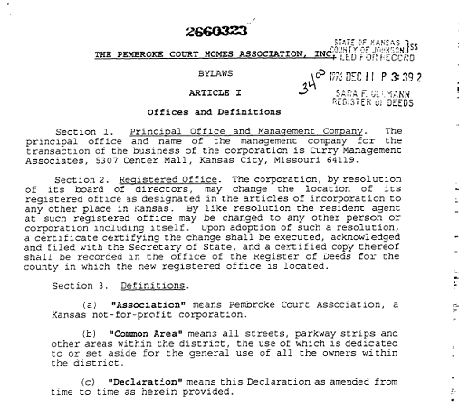
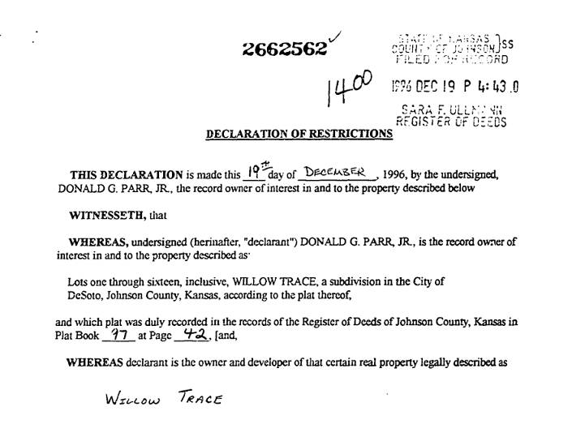
Researched HOA and DOR (Delaration of Restriction) documents on file with the county on each location. Obtained established year from these documents.
Segregation document locations in the data were noted as they were found. If cities would like to be unlink these as live documents for the parcel this will be and easy way to find them. A few small cities have unlinked but many have not. They are archived when they are unlinked. There is a one page form that has to be filled out and filed by the city to the county for this take place which can be also be provided upon request.

Slide 6
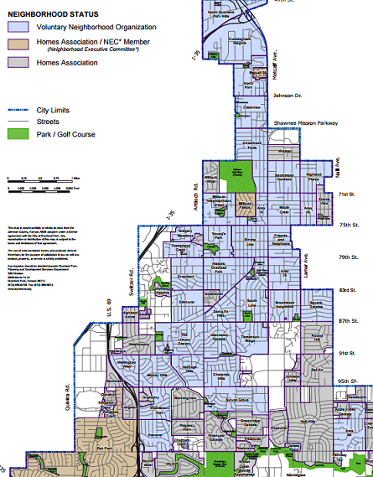
Referenced Overland Park layer called dl.Neighborhoods_pl. This layer did have Voluntary Neighborhood
Worked with Leawood/ Mark Andrasik to review their boundaries/HOA names. Provided mapbooks for reference. (Would love to do this with other cities if they are interested!)

Slide 7
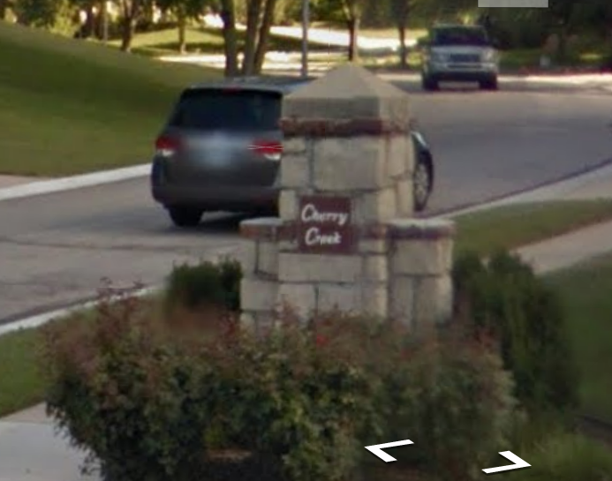
Talked with small cities about HOA collection in late 2015. Many of them did not have any spatial information on them or attribution data on them either.
Used internet searches on property paired with google earth to confirm names and boundaries
Filled out other extraneous HOA information when available. (i.e. – HOA President, contact phone, etc)

Slide 8
Type 1 - HOA with management Company: 227 Type 2 - HOA: 482 TOTAL HOA’S: 709 Covers 74 square miles of the county
Name | HOA's
County | 14
Desoto | 6
Fairway | 6
Gardner | 17
Leawood | 89
Lake Quivira | 2
Lenexa | 56
Merriam | 7
Mission | 8
Mission Hills | 3
Overland Park | 262
Olathe | 124
Prairie Village | 27
Roeland Park | 0
Shawnee | 79
Shawnee Mission | 1
Spring Hill | 7
Westwood Hills | 1
Westwood | 0

Slide 9
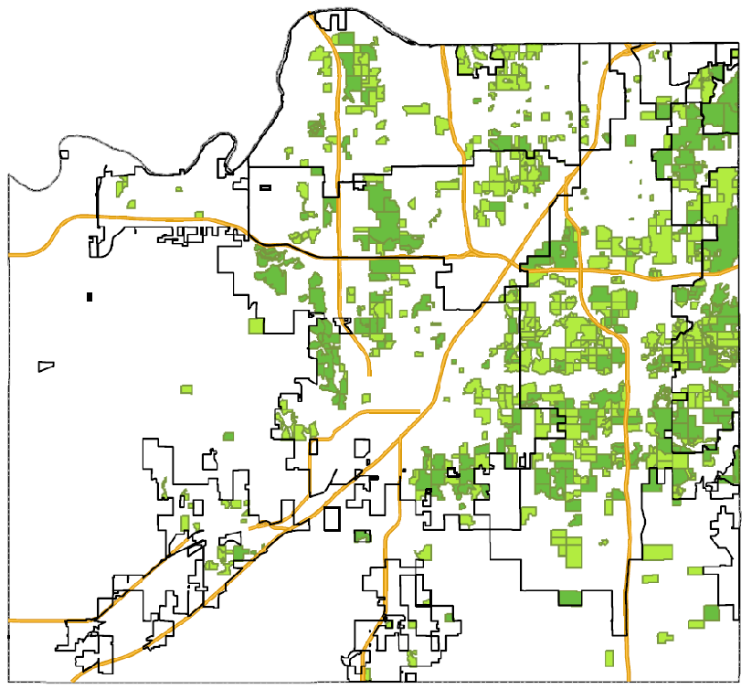
For HOA’s (Type 1 & 2) the following attribution is complete:
Name
Active scale number (1 or 2)
Established year
Dues
Amenities
Type
City
Zip
Total Units
Website (if available)
Management information (if available)

Slide 10
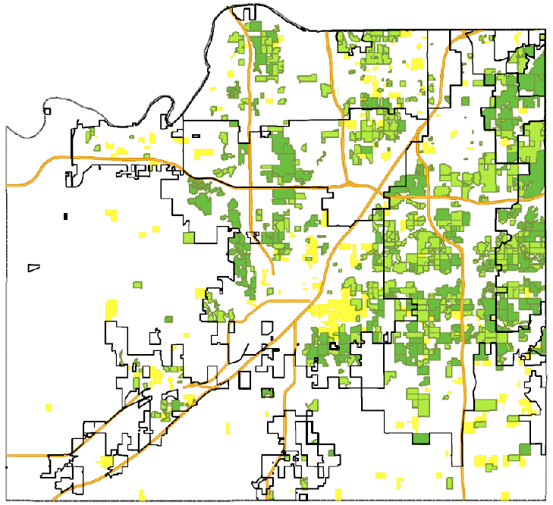
For Restricted areas (Type 3) the following attribution is complete:
Name
Active scale number (3)
Established year
Type
City
Zip
Total Units
RESTRICTED AREAS: 238
Covers 14.5 square miles
Name | Restricted Area
County | 38
Desoto | 11
Fairway | 0
Gardner | 22
Leawood | 5
Lake Quivira | 0
Lenexa | 20
Merriam | 0
Mission | 2
Mission Hills | 0
Overland Park | 29
Olathe | 61
Prairie Village | 7
Roeland Park | 1
Shawnee | 40
Shawnee Mission | 0
Spring Hill | 1
Westwood | 1
Westwood Hills | 0

Slide 11
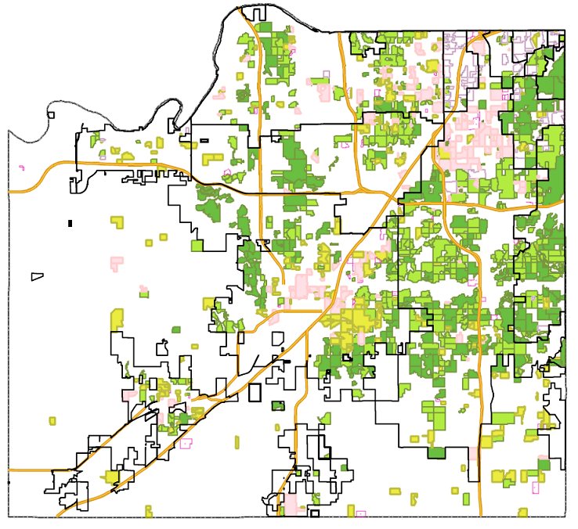
Final completion looks like this
HOAs: 709
RESTRICTED AREAS: 238
VNOs: 59
NEIGHBORHOOD: 138
NEIGHBORHOOD/OTHER: 46
FILTERED OUT Due to TYPE: ~100

Slide 12
Moving Forward:
Have not published but will in next month or so. Still discussing cost/free and what attributes to show
Plan for updating/keeping fairly current
Expansion of attribution. There is still a lot of contact information that is not complete.
Incorporation/framework for other counties? Metro layer?

Slide 13
QUESTIONS?

